Slide 1
Extracting pedestrian activities and tours from smartphone data: a trajectory-based GPS analysis
Ming Xiaomeng Xu
PhD Candidate at School of Planning
Jeff Casello
Professor at School of Planning and Department of Civil and Environmental Engineering

Slide 2
Some Facts in Canada: Mode of Transportation to Work
Province | Walked (%) 2006 | Walked (%) 2016
Canada | 6.4 | 5.5
N.L. | 7.7 | 4.9
P.E.I. | 6.6 | 5.4
N.S. | 8.2 | 6.3
N.B. | 6.6 | 4.6
Que. | 6.6 | 5.6
Ont. | 5.6 | 5.3
Man. | 7.4 | 5.6
Sask. | 8.1 | 5.6
Alta. | 5.9 | 4.5
B.C. | 6.9 | 6.8
Ontario 2006 Ontario 2016
SOURCE: Ontario Census 2016; Statistics Canada 2006
KW Region | 2006 (%) | 2016 (%)
Car, Truck or Van (Driver) | 78.7 | 81.0
Car, Truck or Van (Passenger) | 9.3 | 6.7
Public Transit | 4.6 | 5.9
Walked | 5.1 | 4.4
Bicycle | 1.6 | 1.1
Other | 0.8 | 0.8
SOURCE: Statistics Canada 2006
SOURCE: Region of Waterloo Census 2016, Place of work and commuting to work
Notes:
Here’s some quick facts about walking in Canada.
We talking about pedestrians for decades.
In 2006, Ontario had the lowest proportion of people walking to work. From 2006 to 2016, the proportion is decreasing. In KW region here, the walking is also decreasing.

Slide 3
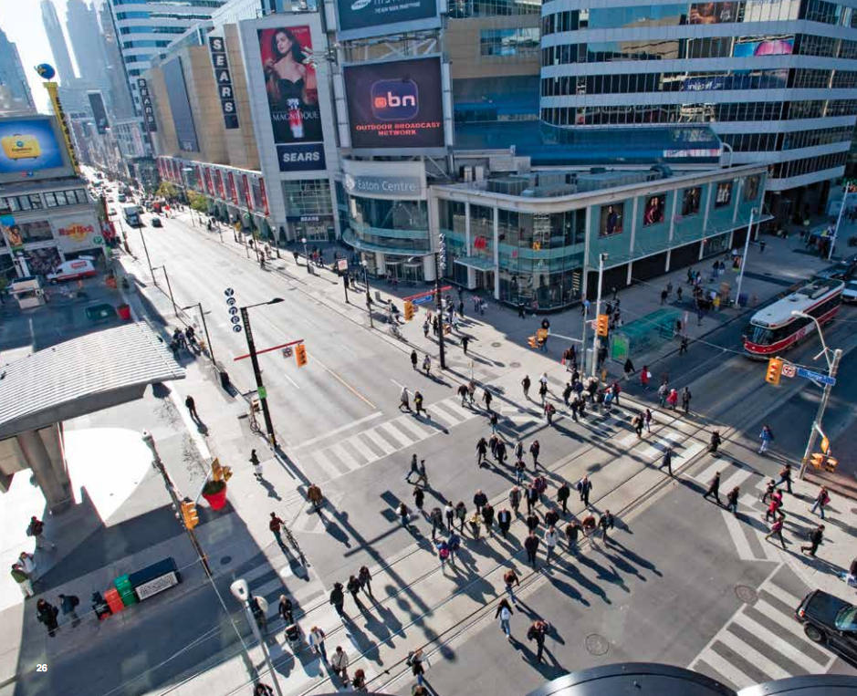
Introduction
Municipalities in North America are eager to increase walking
to promote:
Sustainable transport
Public health
Urban vibrancy
Local economy
to reduce/limit:
Urban sprawl
Car dependency
Emissions
https://www.tcat.ca/wp-content/uploads/2017/03/ATPBtG.2017.03.16.forweb-1.pdf
https://www.toronto.ca/wp-content/uploads/2017/11/990f-2017-Vision-Zero-Road-Safety-Plan_June1.pdf
Notes:
We all know there’re a lot of benefits of walking. it can benefit the public healthy, reduce emissions, promote social interactions, urban vibrancy, and community development.
Also, there is the fact that people access transit by walking. improving access and connections to transit by walking can also help to promote public transit.
Because of that, a lot of plans, policies are trying to promote walking. Toronto has the VisionZero plan to increase the pedestrian safety. projects can be found from Active Transportation Planning Beyond the Greenbelt.
For mid-cities like KW region, we have active transportation plan to promote walking.
I think it is the right time for us to addressing impacts of investments in or policies towards walking. to do so, we need a better model to represent pedestrian.

Slide 4
Primary Obstacles to Improve Pedestrian Models
To address the impacts of investments and policies towards walking, we need better representation of pedestrians, but to date:
Insufficient empirical data (Singleton et al., 2018)
Inappropriate travel survey design/methods (Harding et al., 2018)
Inappropriate zonal structure (Iacono, 2010; Clifton, 2016)
Failure to consider pedestrian tours in satisfying activities
Models failed to correlate these tours’ attributes to different urban forms
Notes:
Current zonal structure, both FSM and ABM, have difficulty dealing with short distance trips/walking trips, and also transit access/egress
Dr. Clifton 2018: Behavioral data remains among the most substantial challenges for modeling walking;
travel surveys did not always adequately rep- resent non-motorized travel. Some
TTS: under-reporting trips
A common phrase in transportation planning is that if it isn’t counted, it doesn’t count, meaning true multi-modal planning is limited when data is missing or of poor quality. While many jurisdictions have had policies supporting multimodal transportation for at least a decade, transportation conditions are often measured using vehicle delay-based level-of-service. This results in transportation improvements focused on moving autos more efficiently. Because more traditional forecasting tools do not account for walking and bicycling, new forecasting tools are being created and used that can account for and address active transportation.
Dynamic zonal structure to

Slide 5
Research Objectives
Our goals include gathering empirical data on pedestrian tours to:
Extract pedestrian activities and tours;
Classify pedestrian tours as unimodal or multi-modal, by origins and purposes;
Quantify those tours’ distances, duration and activities completed.
Subsequent work will:
Correlate these tours’ attributes to the built environment;
Develop and embed techniques for pedestrian tour to be included in travel forecasting models;
Grow the number of pedestrians.

Slide 6
Extracting Key Elements from GPS
Activities: Purpose of travel
Location, duration, utilitarian actions
Trips: Travel that separates two activities
OD, path, duration
Stops: Travel stops or activities
Location, duration
To determine activities, trips, and stops
Identify when an activity takes place
Differentiate travel stops from activities
Notes:
There are several defining characteristics of GPS data observed during activities.
People travel to accomplish activities.
the definition of a trip is the purposeful travel between two activities

Slide 7
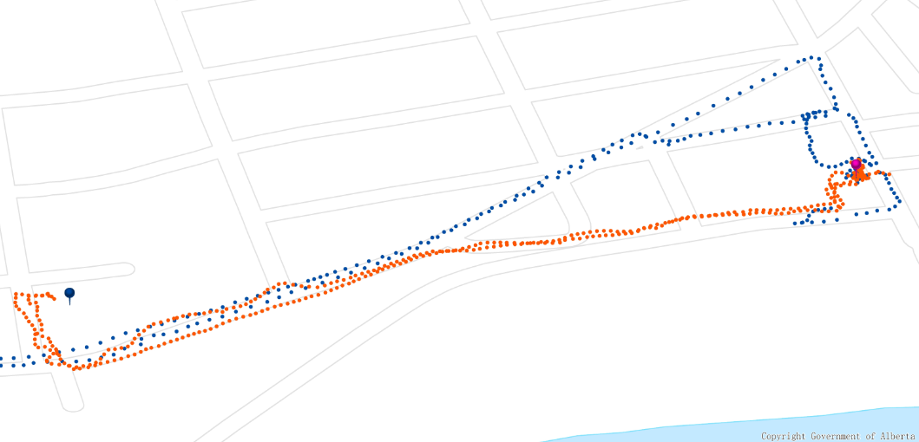
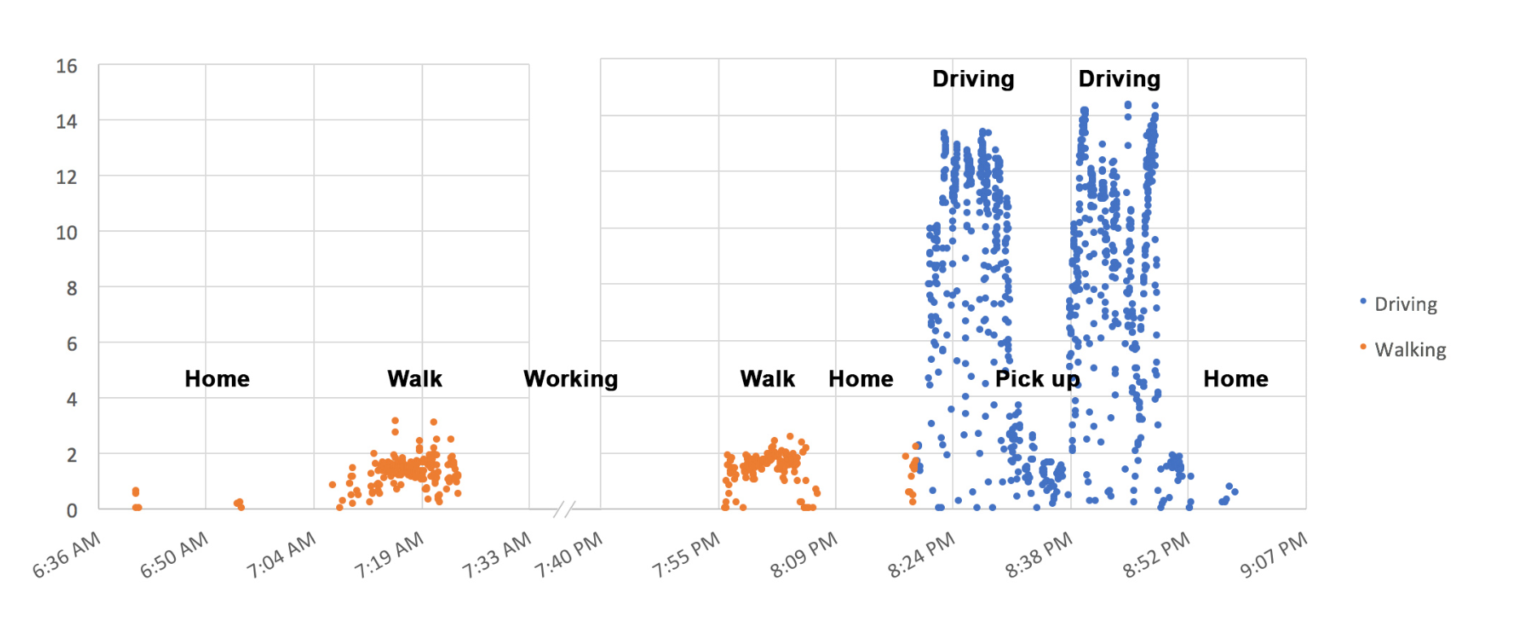
Extracting Activities: Case study in Edmonton, AB
Criteria 1: Low speed + dwell-time threshold
We consider a series of points below the speed threshold is a stop which potential to be an activity
GPS Trajectory walking vs. driving
GPS Points in Time-Speed
Notes:
For many activities, one would expect the participant to be fully stationary (such as sitting at one’s desk at work) or moving at a slow walking speed (such as when shopping).
In some cases, the data reflect extended periods of near zero velocities. In most cases, however, even when a smartphone is stationary, the GPS data collected tend to indicate some movement, often with speeds that may reflect cycling or walking travel.
Typically, these inaccurate velocities are generated because the strength of the satellite signals changes over time and, as a result, the location coordinates can vary, sometimes significantly.

Slide 8
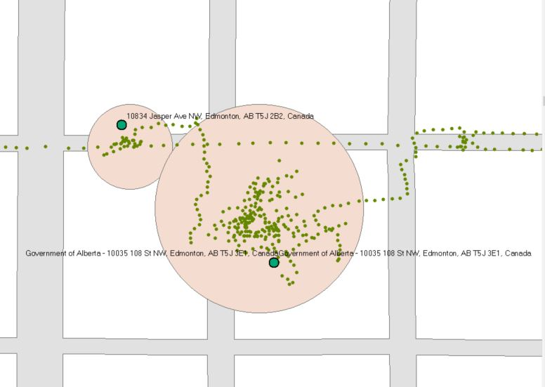
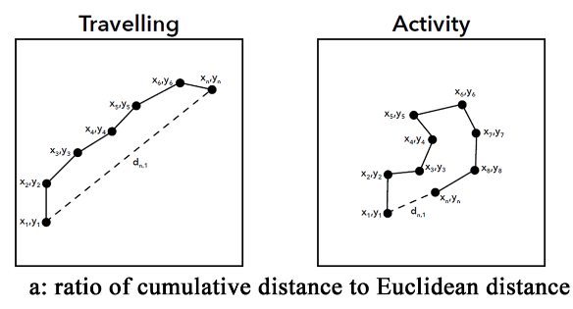
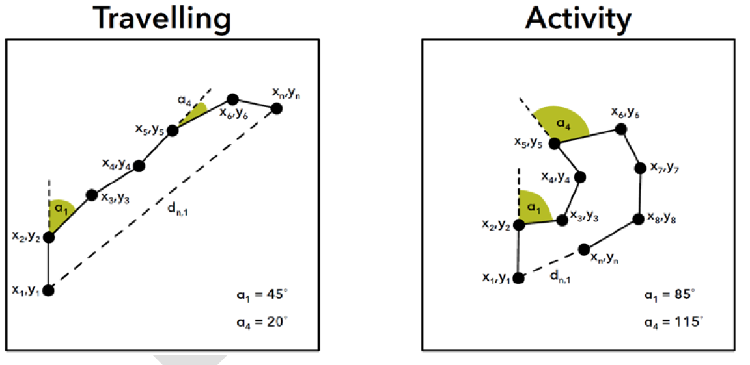
Extracting Activities
Criteria 2: Circuitous trajectories
Ratio of cumulative travel distance to Euclidean distance between start point and end point
Cumulative deviation in bearing
Notes:
When a participant is traveling between activities, the path taken tends to reflect a directness in travel. During an activity, participants’ movements exhibit much greater circuity.
We can also measure the (in)directness of travel using cumulative deviation in bearing. If a series of GPS points constitute a straight line, the sum of the angles created by lines connecting these points will total nearly zero. When travel is circuitous, the sum of the angles created will greatly exceed zero. During activities, the GPS data generate much higher cumulative deviations in bearing than during travel. Figure 2 demonstrates these observations graphically.

Slide 9
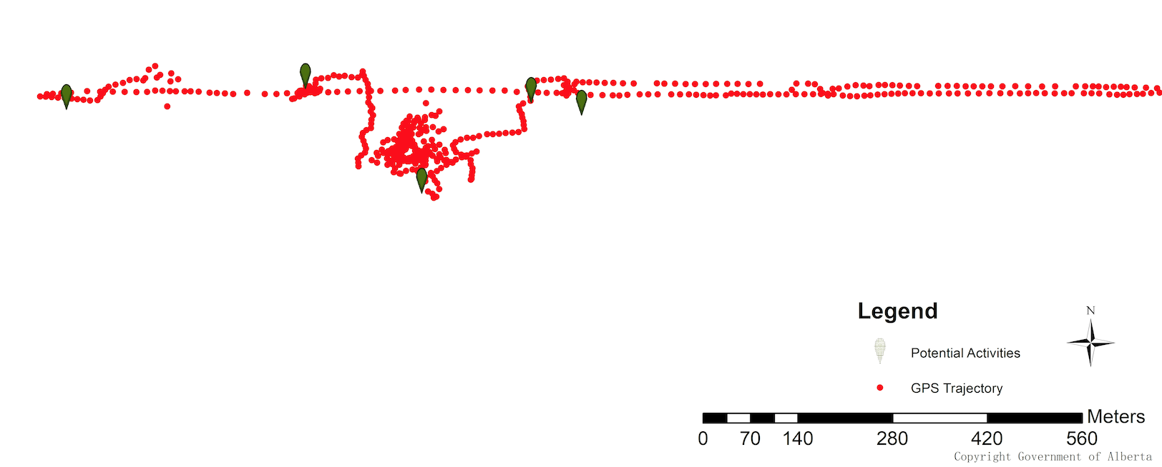
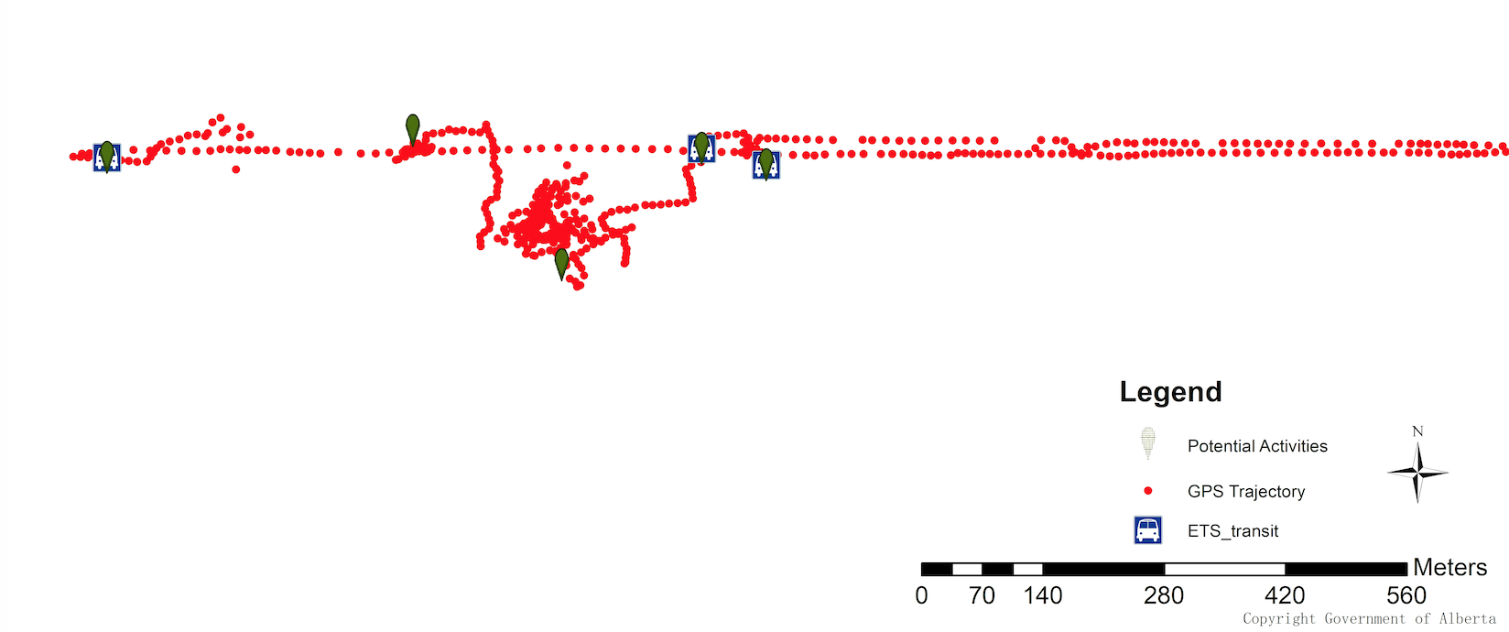
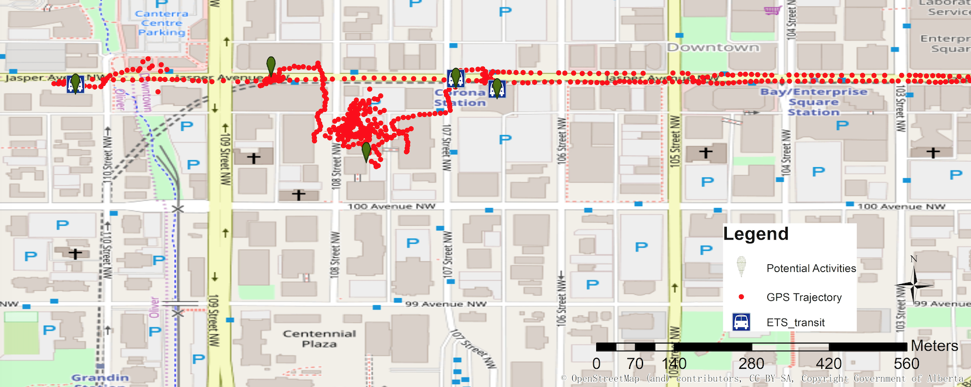
Extracting Activities
4
3
1
5
2
Criteria 3: Spatial indication of activities
Distance from the roadway network
Land use map matching
Potential activities
4
3
1
5
2
1: Transit egress
4: Waiting for transit vehicles
5: Transferring transit vehicles
4
3
1
5
2
2: Working
3: Dining out at restaurant
Notes:
The first two characteristics are effective in identifying purposeful travel from activities. However, when a traveler experiences a stop (at a traffic signal, for example) the GPS data often have similar characteristics as activities – low speeds and circuitous GPS points.

Slide 10
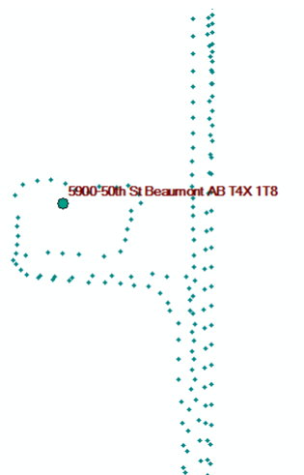
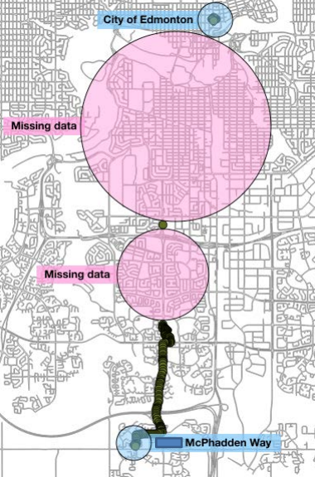
Representative Examples of Errors
The circumstances under which the Activity Detection algorithm did not work well include:
Inattentive users and inconsistent GPS data;
Entry to tunnels;
Travel by LRT;
When travel includes “drive-thrus”.
Undetected trips to a drive thru
Missing data as a result of lost signal/ app crash

Slide 11
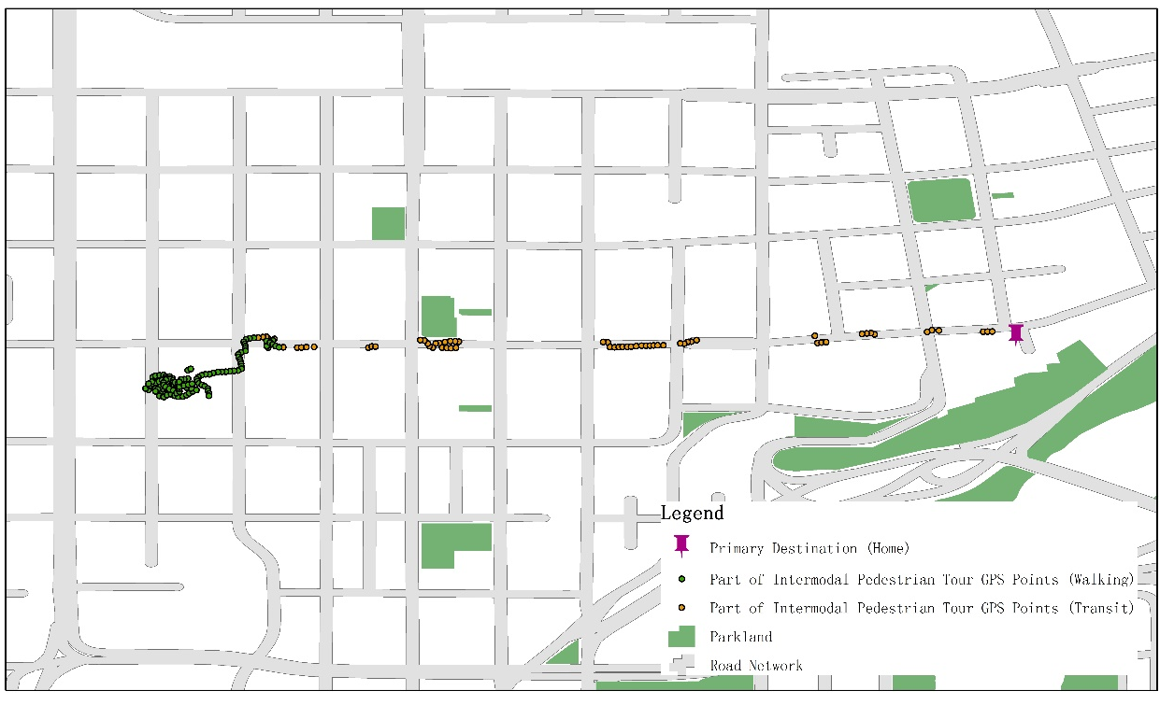
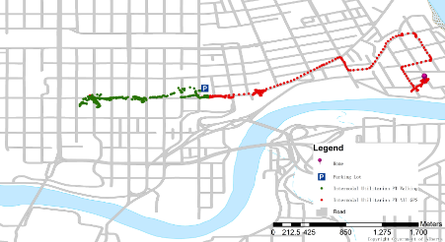
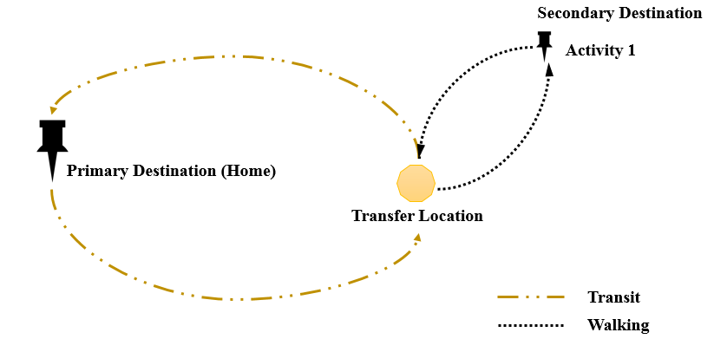
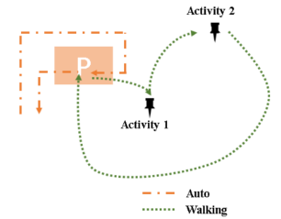
Typology of Pedestrian Tours: Uni- & Multi-modal
Home-based utilitarian pedestrian tour
Utilitarian pedestrian tour
Notes:
Access mode
A tour not only links the activities and related trips, but also reflects the sequence, frequency, and duration
of scheduled activities.

Slide 12
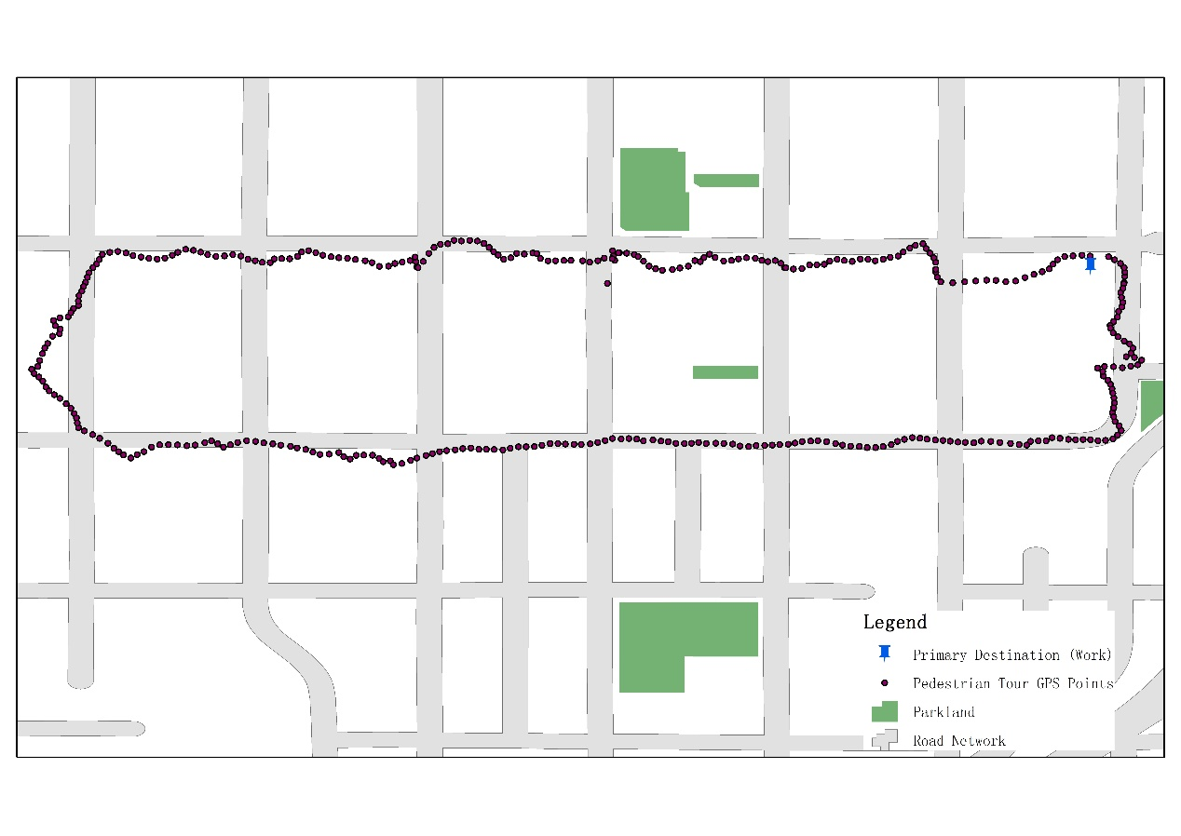
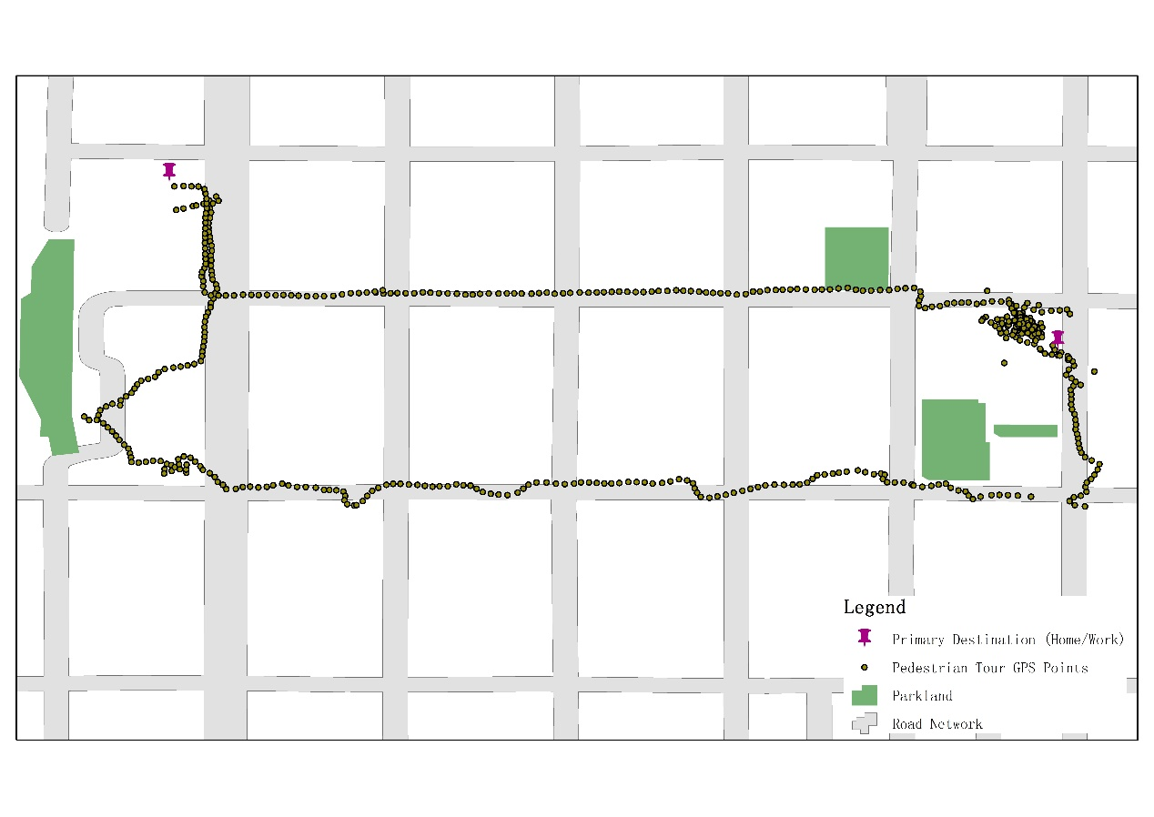
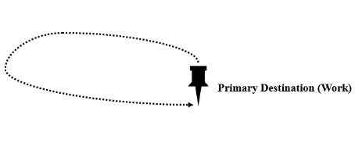
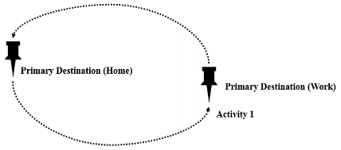
Typology of Pedestrian Tours: Purposes
Recreational Utilitarian
Primary Origin (Home) & End Destination
Primary Destination (Work)
Work-based recreational pedestrian tour
Home-based utilitarian pedestrian tour
Notes:
Purpose

Slide 13
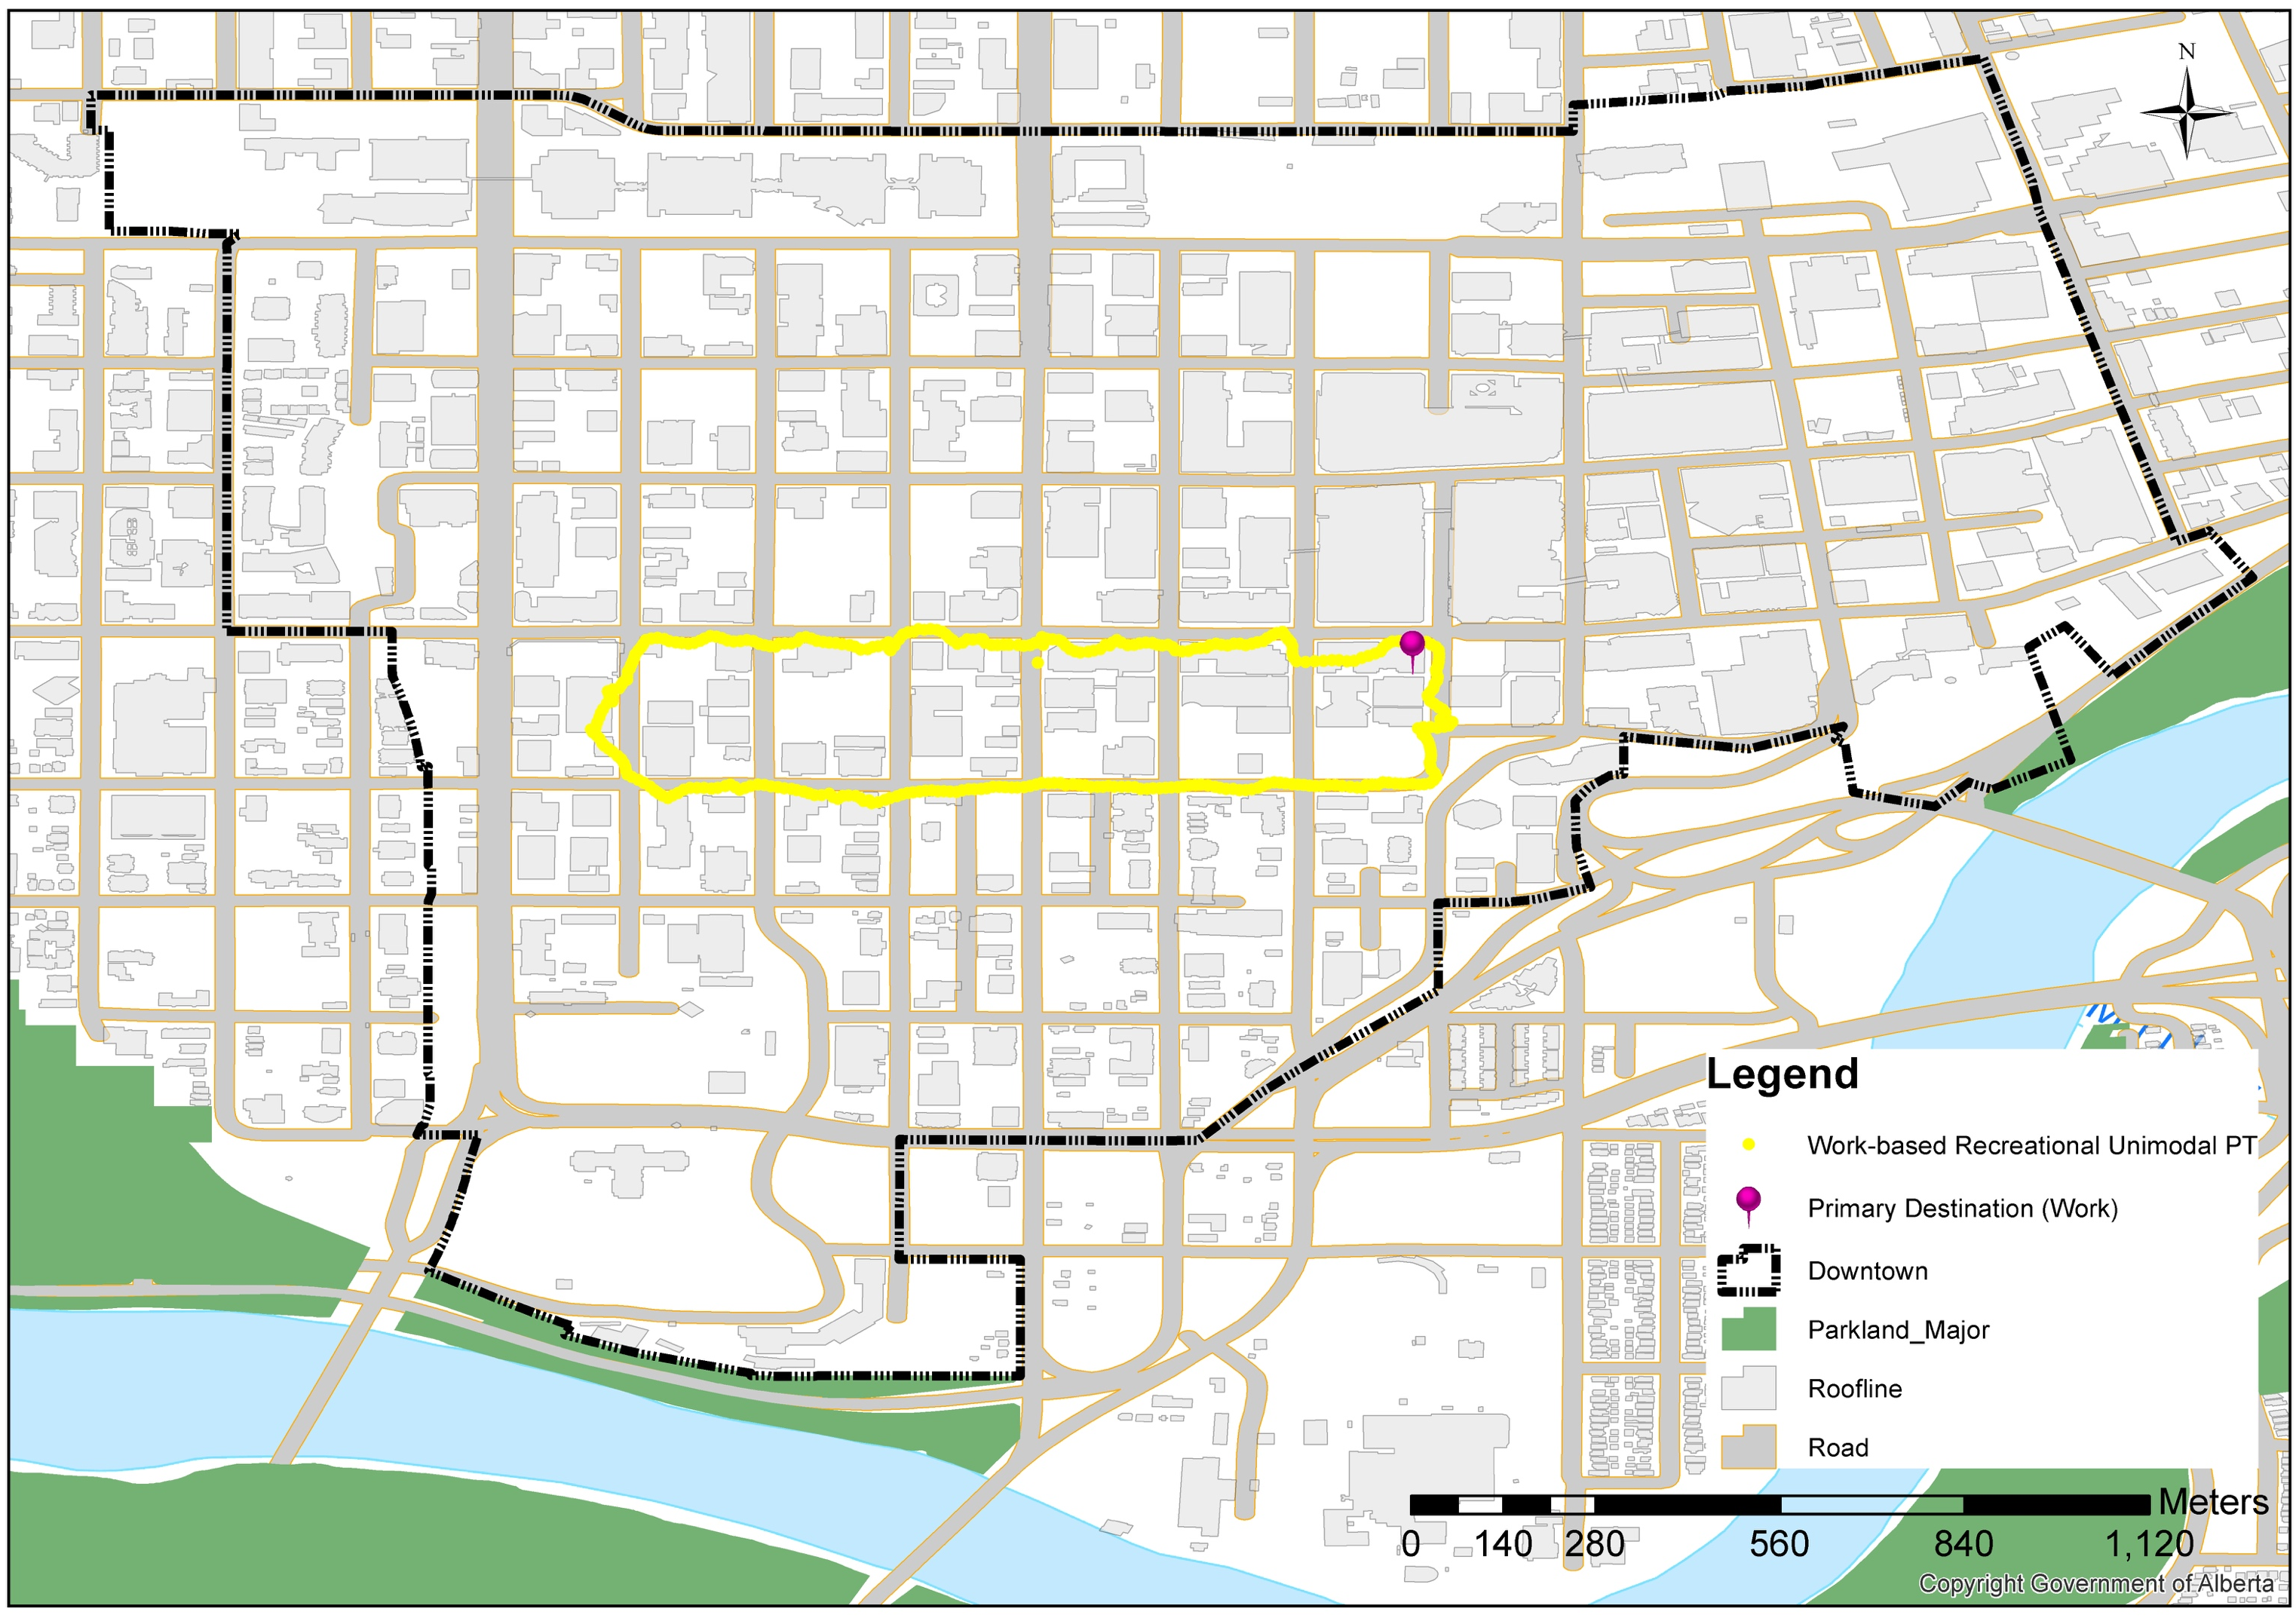
Complexity of Pedestrian Tours: Simple
Unimodal Recreation Pedestrian Tour Travel GPS Trajectory
Notes:
Distribution of destinations and number of activities

Slide 14
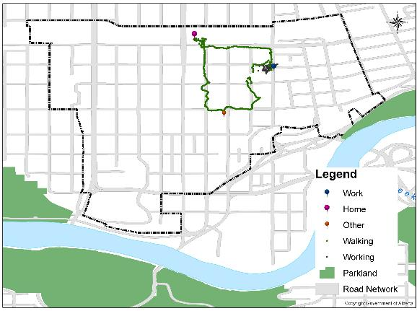
Complexity of Pedestrian Tours: Complex
Unimodal Utilitarian Pedestrian Tour Travel GPS Trajectory

Slide 15
Conclusion and Future Work
Gathering robust, spatially and temporally disaggregate data on pedestrian tours allows for inclusion of pedestrian activities in travel forecasting models;
As a result, investments in or policies towards pedestrians can be evaluated for their impacts on system performance through conventional or activity based models;
Major investments in other transportation modes – LRT, for example – or changes in built environment – can also produce changes in pedestrian activities.
Notes:
﻿To future generations of active travelers – be they walking, cycling, skating, skipping, scooting, rolling, or otherwise moving under human power – in the hopes that one day the transportation planning and engineering professions will give you the same dignity and attention as is given to other road users.
Will give active travlers same attent as is given to other road users.

Slide 16
With special thanks to
Shangwei Yu;
Pedram Fard;
Yue Zhao

Slide 17
Contacts
Ming
xiaomeng.xu@uwaterloo.ca
Professor Jeff Casello, Ph.D., P.E.
jcasello@uwaterloo.ca
UWaterloo WPTI
https://uwaterloo.ca/waterloo-public-transportation-initiative/

