Slide 1

Pedestrian Tours in Different Urban Forms: Evidence from Smartphone Data
Xiaomeng Xu¹
Dr. Jeff Casello²
Presentation For
The Science behind Hands on Sustainable Mobility
¹School of Planning, ² School of Planning and Department of Civil Engineering
University of Waterloo
Karlsruhe, Germany
22 May 2019
Notes:
Active transportation in north America truly need more attentions. So for today, I would like to talk about walking, one of the very important active transportation modes.

Slide 2
Presentation Outline
Introduction and Research Objectives
Study Area and Data Collection
Pedestrian Tours: Typology and Complexity
  Purpose of walking
  Modal properties
  Number of activities
  Distribution of destinations
Pedestrian Tours in Different Urban Forms
  Where pedestrian tours take place?
  Translation of the data into modeling
Future Work
Notes:
Our work in waterloo, is trying to understanding and modeling pedestrians in a meaningful way.
And trying to answer how can we better represent pedestrians by using the data passively collected from smartphones.

Slide 3
Introduction
Province | Canada | N.L. | P.E.I. | N.S. | N.B. | Que. | Ont. | Man. | Sask. | Alta. | B.C.
Walked (%) 2006 | 6.4 | 7.7 | 6.6 | 8.2 | 6.6 | 6.6 | 5.6 | 7.4 | 8.1 | 5.9 | 6.9
Walked (%) 2016 | 5.5 | 4.9 | 5.4 | 6.3 | 4.6 | 5.6 | 5.3 | 5.6 | 5.6 | 4.5 | 6.8
SOURCE:
http://onlinepubs.trb.org/onlinepubs/trnews/trnews280westerneurope.pdf
Statistics Canada, 2006, 2016
Notes:
I would like to give you guys some quick facts.
Note: The available travel surveys were used for each country; the year of the survey is noted in parentheses after each country’s name. Dissimilarities in data collection methods, timing, and variable definitions limit the comparability of the modal shares shown. [Sources: Danish Ministry of Transport (MOT), British Department for Transport (DfT), German MOT, Statistics Netherlands, U.S. Census Bureau, U.S. Department of Transportation (DOT), and Norwegian Institute of Economic Research.]

Slide 4
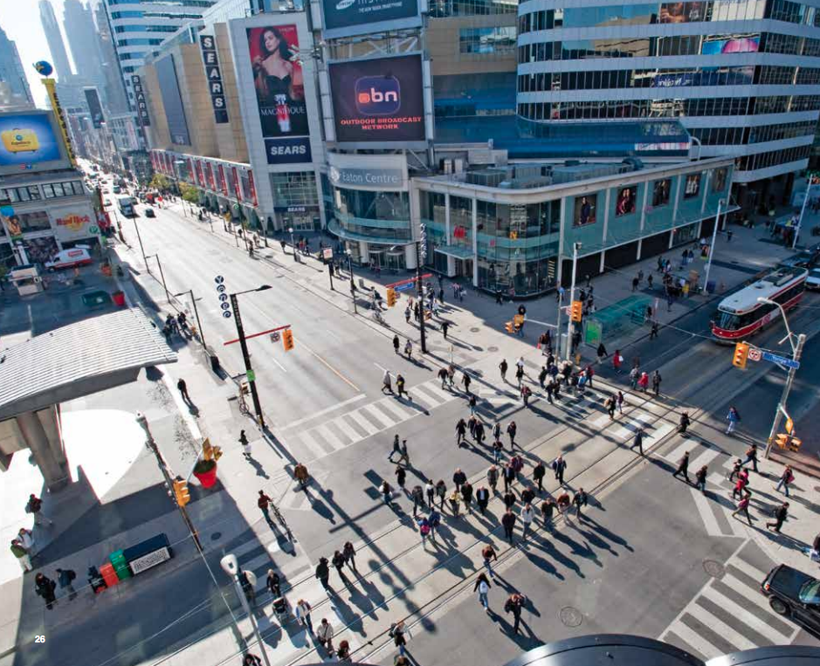

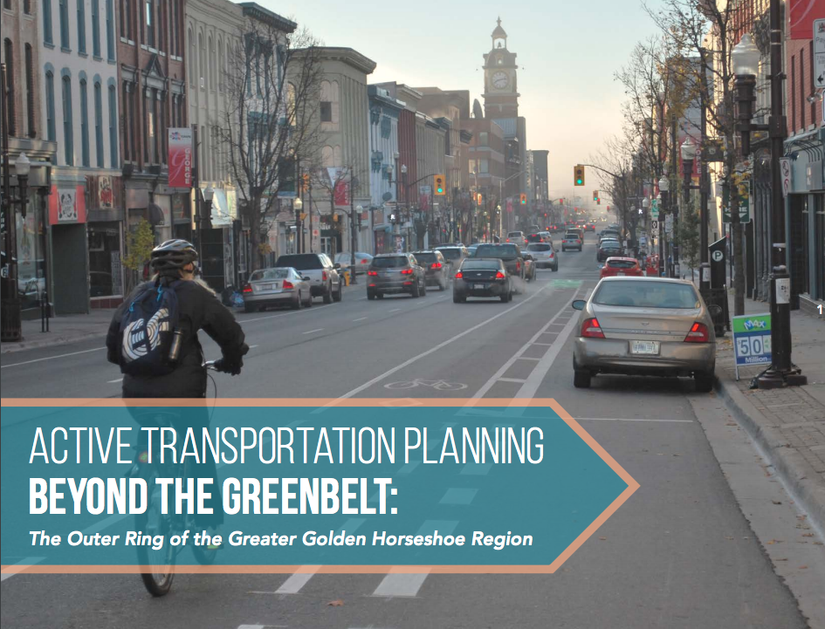
Introduction
Municipalities in North America are eager to increase walking to promote:
    Sustainable transport
    Public health
    Urban vibrancy
    Local economy
to reduce/limit:
    Urban sprawl
    Car dependency
    Emissions
https://www.toronto.ca/wp-content/uploads/2017/11/990f-2017-Vision-Zero-Road-Safety-Plan_June1.pdf
https://www.tcat.ca/wp-content/uploads/2017/03/ATPBtG.2017.03.16.forweb-1.pdf
Notes:
In Canada, we have been talking about pedestrians for decades.
Increasing pedestrians can benefit the public health, urban vibrancy, at same time reduce emissions. We also have a lot of plans to encouraging walking such as Vision Zero and Active transportation master plan.

Slide 5
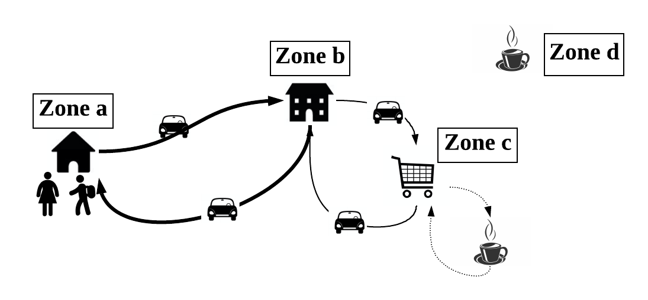
Introduction
To address the impacts of investments and policies towards walking, we need better representation of pedestrians, but to date:
  Insufficient empirical data
  Pedestrian trips are not modeled in current travel forecasting models
  Models failed to correlate these tours’ attributes to different urban forms
Notes:
We also asking how can we get meaningful returns of those plans and investments. What policies need to change if we want to encourage people to walk. Even though with all those opportunities, we don’t have a good models to evaluate them.
Failure to consider pedestrian tours in satisfying activities
to addressing impacts of investments in or policies towards walking. to do so, we need a better model to represent pedestrian. But we’re facing several difficulties.
How pedestrian tours can satisfy people’s daily activities.

Slide 6
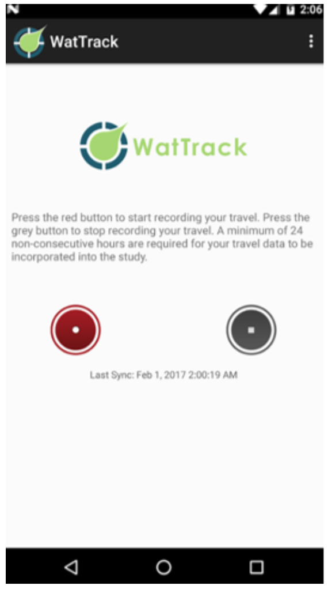
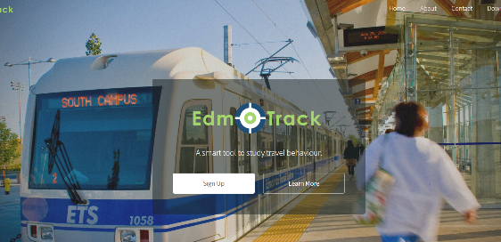
Research Objectives
Our goals include gathering empirical data on pedestrian tours to:
  Classify pedestrian tours by modes, origins and purposes;
  Quantify those tours’ distances, duration and activities completed;
  Correlate these tours’ attributes to the built environment;
  Develop and embed techniques for pedestrian tour; inclusion in travel forecasting models;
  Grow the number of pedestrians.
Notes:
Even though with all these opportunities, we don’t really have models to evaluate it. In our research, our goal is to do some data collection, and use the empirical data we gathered to inform travel forecasting model.
And also quantify their attributes in terms of distance and duration.
All these pedestrian tours begin and end at the same location.

Slide 7
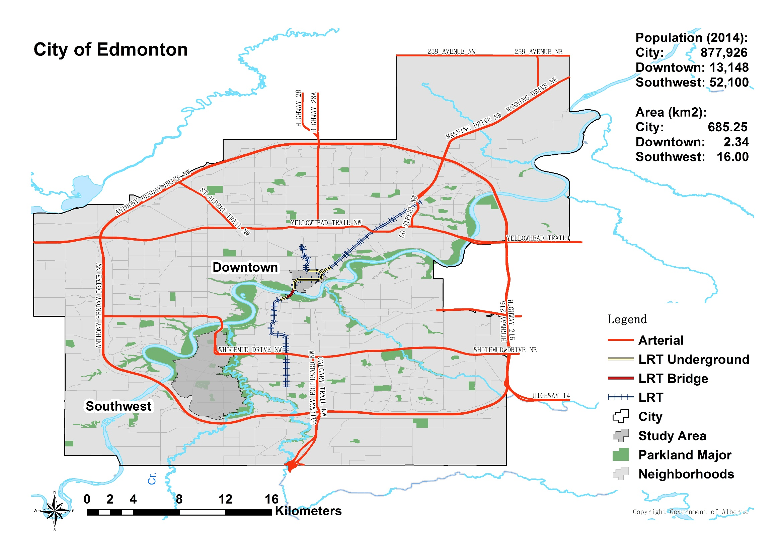
Study Area: Edmonton, Alta., Canada
~1700 participants
~4.5M GPS points
~5000 traces
Notes:
This what we did in Edmonton. We worked with the city and a company on their household travel survey. We gave them our app, so we can gather their travel tragecyories in terms of longtitude latitude, speed and time.
We have about 1700 participants, over 4million of GPS points in our dataset, and about 5000 traces.
Downtown Edmonton is here, there is a very dense urban area, there is a very dense suburban areas in here.
We just took the pedestrian traces that were happening in those two different areas, so we can compare urban and suburban area.

Slide 8
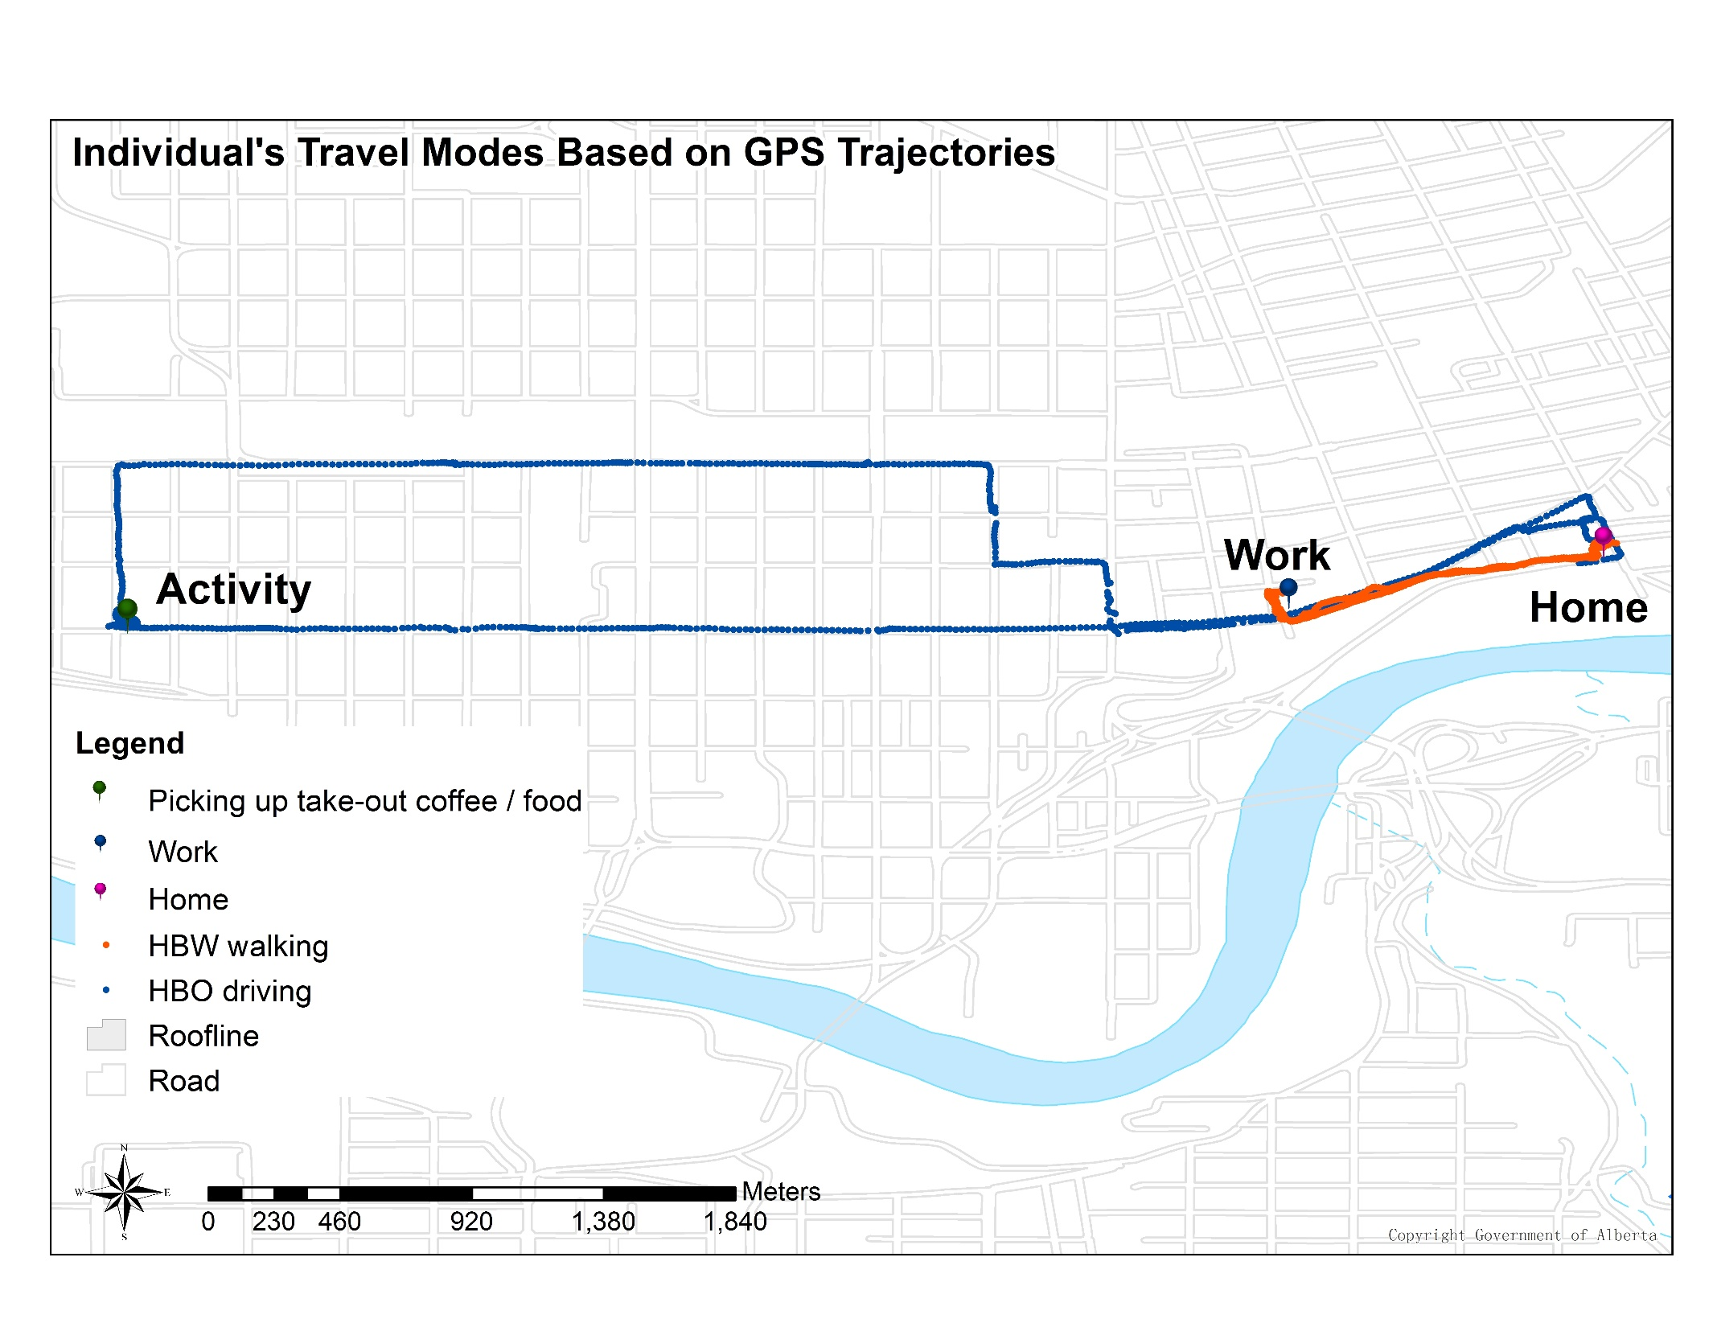
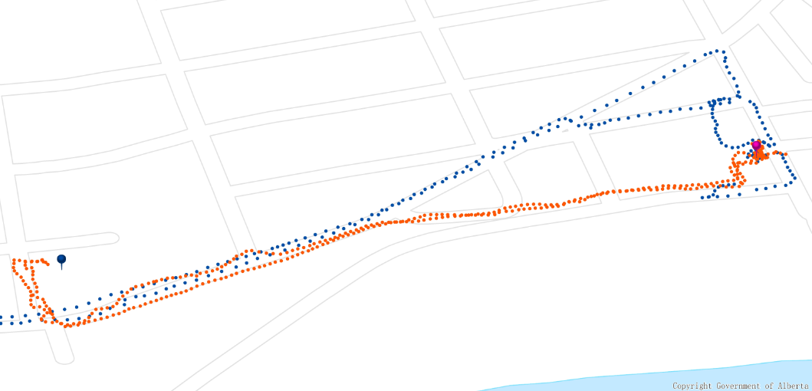
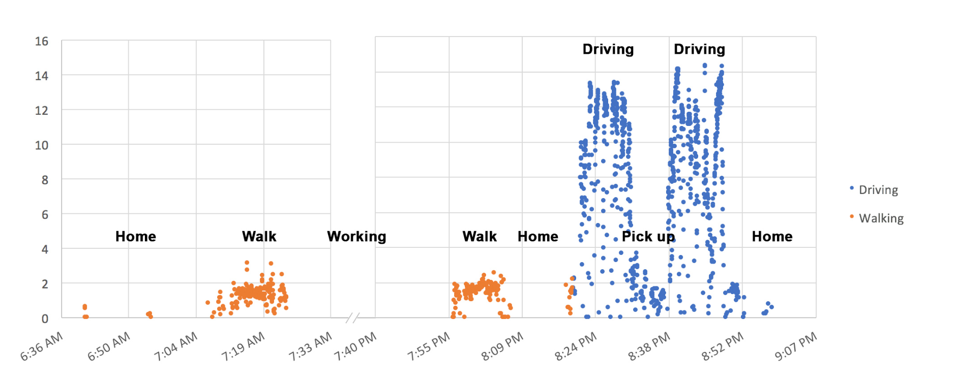
Data Example: from Edmonton
GPS Trajectory walking vs. driving
GPS Points in Time-Speed
Notes:
This is bascally what the data looks loke. this individual make a pedestrian tour start from home to work, and then walk from work to home.
At evening, they take longer auto trips and conduct an activity. If you look at the speed vs. time, this is what the data looks like.
So we displaying those data, The first thing we do is classify the tours

Slide 9
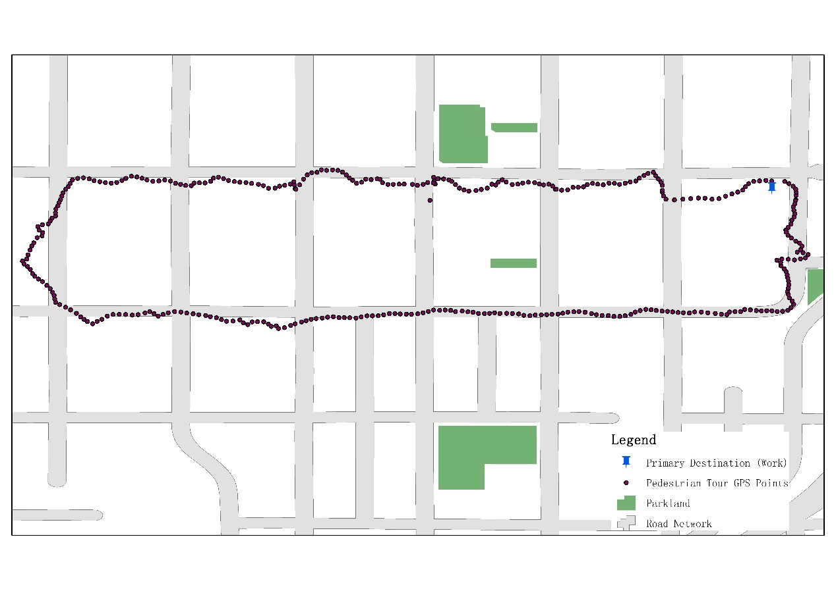
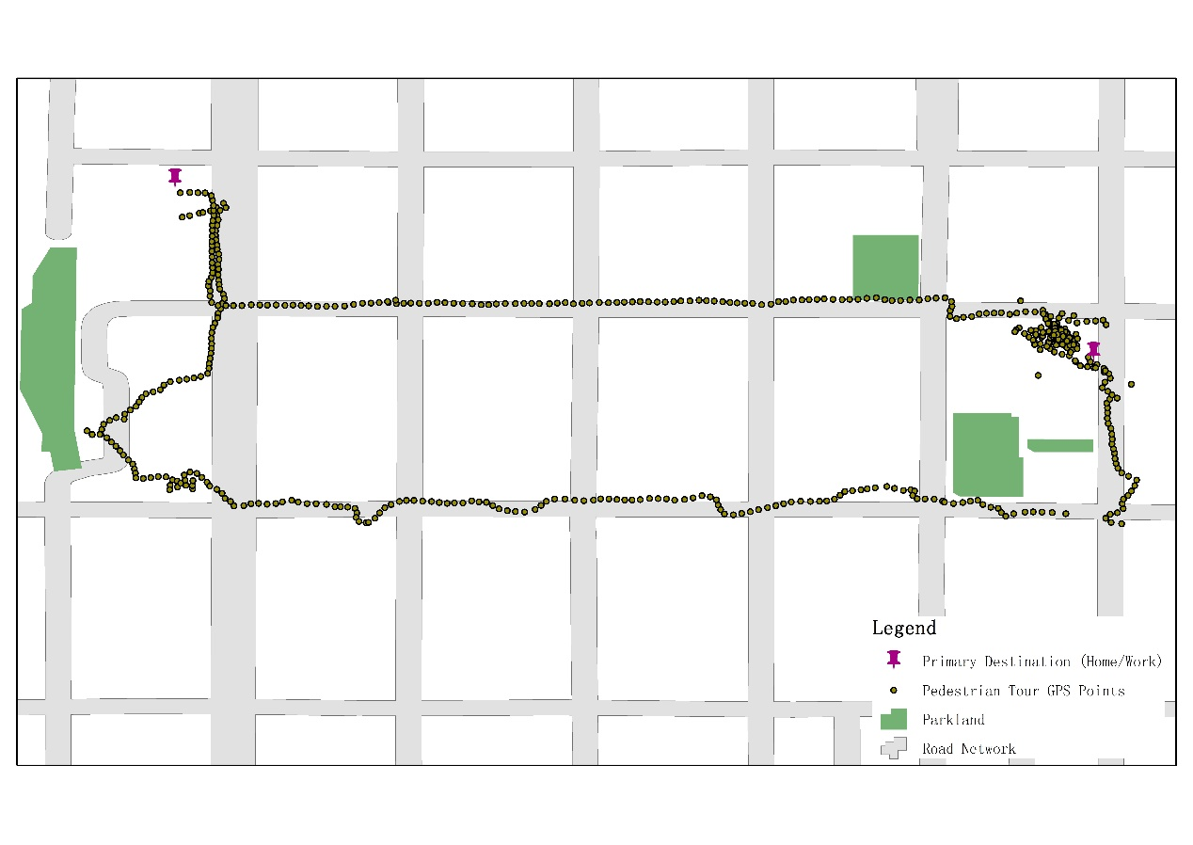
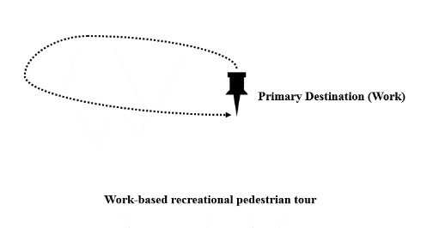
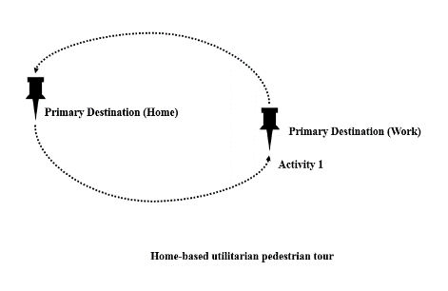
Typology of Pedestrian Tours: Purposes
Recreational Utilitarian
Primary Origin & Destination (Work)
Primary Origin (Home) & End Destination
Primary Destination (Work)
Work-based recreational pedestrian tour
Home-based utilitarian pedestrian tour
Notes:
Classify those tours based on the travel purpose and complexity. If we think about pedestrian tours, normally you start from one location, walk and make several paths, and then back to the same location.

Slide 10
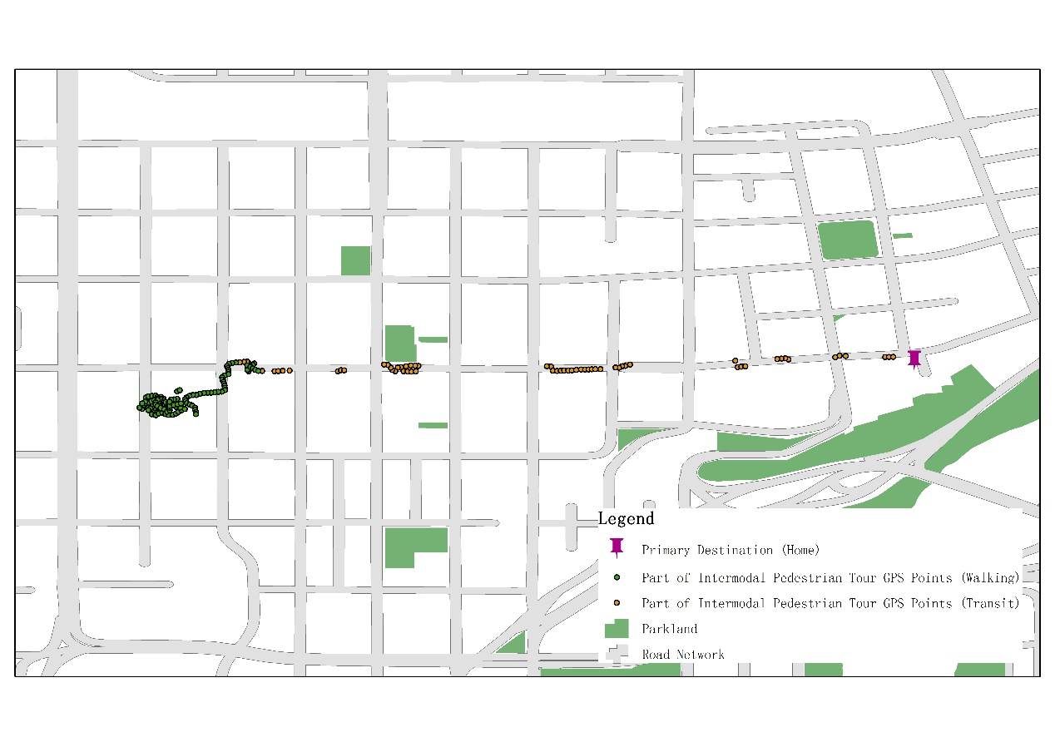
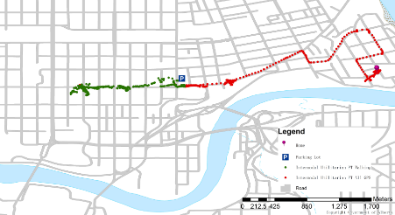
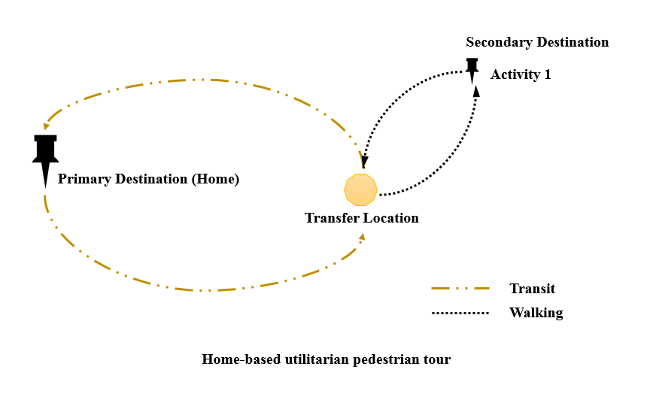
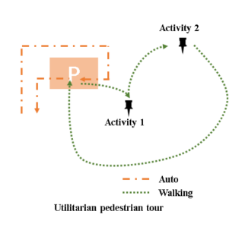
Typology of Pedestrian Tours: Modes
Home-based utilitarian pedestrian tour
Utilitarian pedestrian tour
Notes:
A pedestrian tour can be linked with other modes. professor hupher also talked about the muktimodal tours.
Recreation/utilirian
Unimodal/intermodal
Now we have intermodal tour, now you have transfer location, and you conduct activities by walking
Do it involve transit, do it involve auto

Slide 11
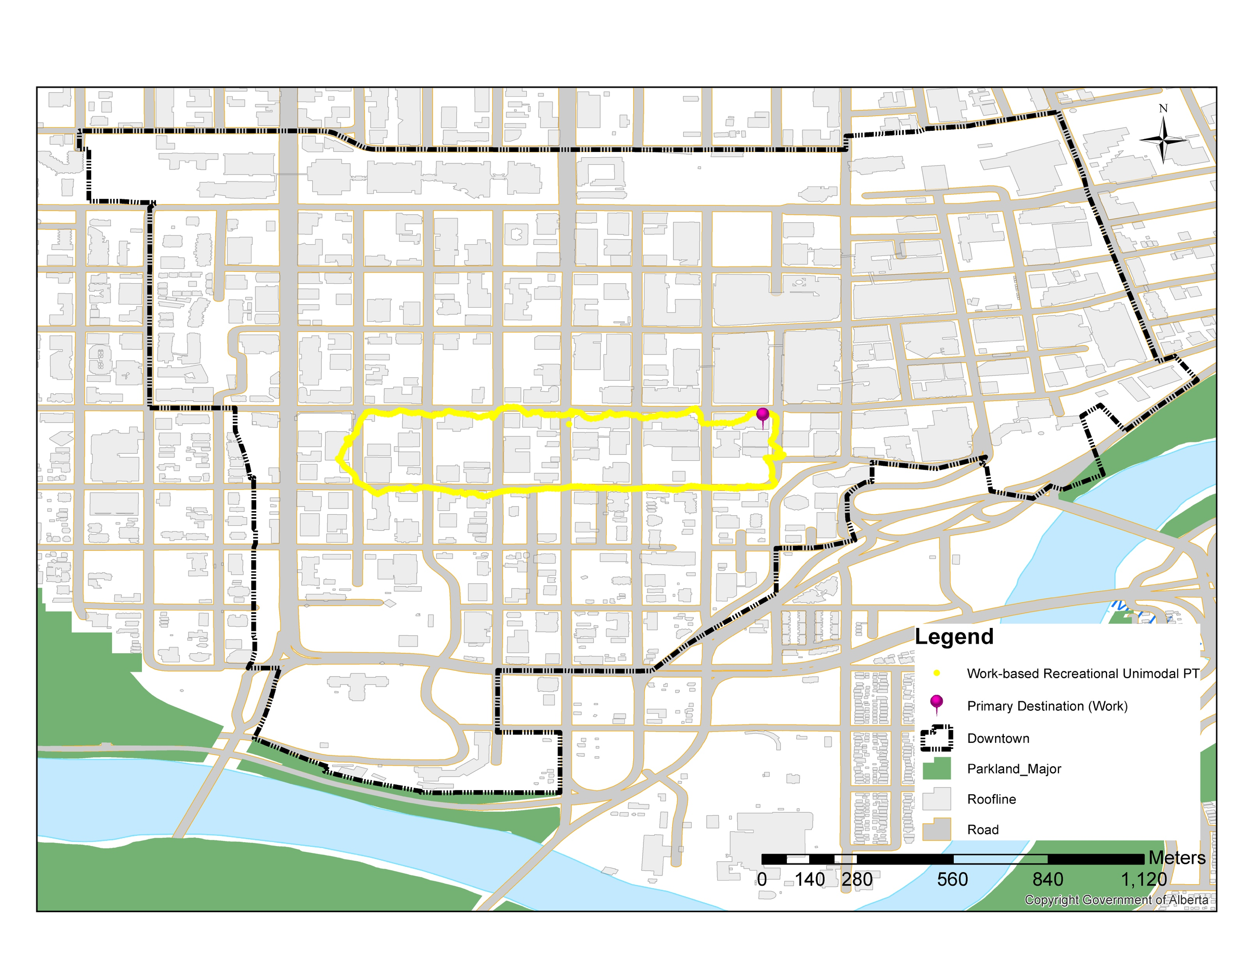
Complexity of Pedestrian Tours: Simple
Unimodal Recreation Pedestrian Tour Travel GPS Trajectory

Slide 12
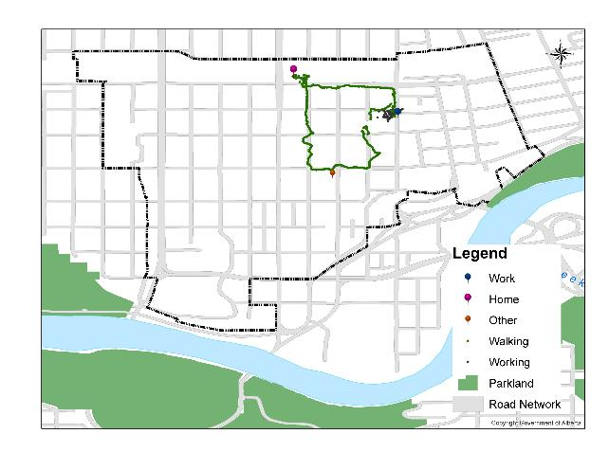
Complexity of Pedestrian Tours: Complex
Unimodal Utilitarian Pedestrian Tour Travel GPS Trajectory
Notes:
Here’s another case, you walk to work, spend 8 hours
You do some social at evening, and then you walk home.
Based on the observations, we can say is it a

Slide 13
Observed Activities on Pedestrian Tours
Notes:
We can also talk about the pedestrian activities accomplished by each tour.
The most frequent

Slide 14
Distribution of Duration
Intermodal Pedestrian Tour Travel in Downtown and Suburban
Intermodal and Unimodal Walking Time in Downtown and Suburban
Time (Mins)
Downtown
Suburban
Note: Total Travel Time = Travel Time + Activity Time
Notes:
How long do people spend on these pedestrian tours, because we need to spatially understand what is the boundary of the tours are. So there are some observations, these are minutes, the orange is in dowmtown, so ypu have longer

Slide 15
Distribution of Distance
Intermodal Pedestrian Tour Travel Distance in Downtown and Suburban
Unimodal and Intermodal Walking Distance in Downtown and Suburban
Downtown
Suburban
Notes:
And we did the same thing to distance

Slide 16
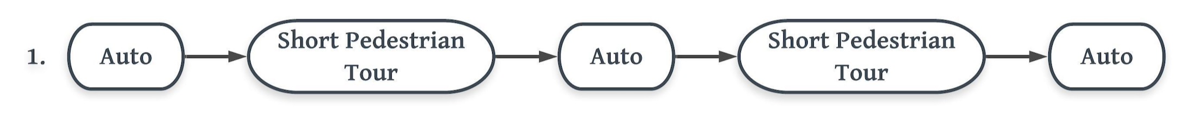
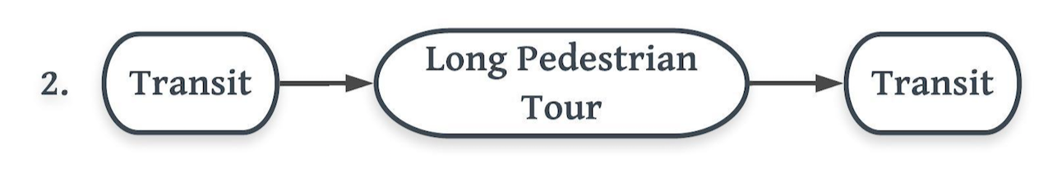
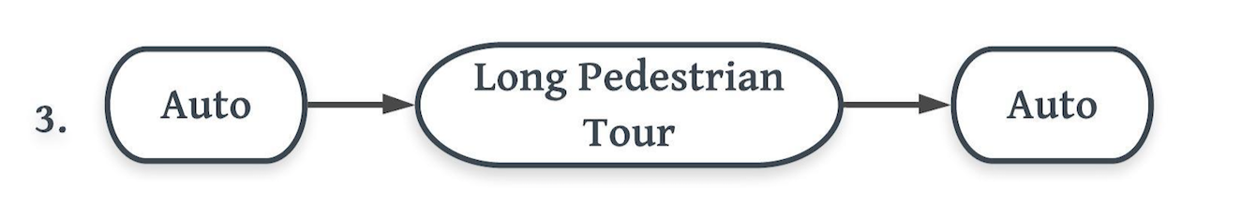

Commonly Observed Pedestrian Tours
Multiple errands run with long auto trips followed by short pedestrian tours – parking lot to the store, back to the vehicle. Common in suburban areas.
Transit access from suburban areas to downtown; long pedestrian tour accomplishing multiple activities.
Auto access to parking – at destination in suburban areas, adjacent to core downtown area; long pedestrian tour accomplishing multiple activities.
Auto access from suburbs to transit (P+R); travel to downtown for work / other activities; return home by transit-to-auto
Notes:
In summary, a pedestrian tour not only links the activities and related trips, it also reflects the sequence, frequency, and duration of scheduled activities.
Out of those data, the most common tours we saw is the first one. very common shopping activities in suburban.
From their car, they go to store, come back to their car, drive to the next stop,
2.3 suburban to downtown connection. are different ways to access downtown, and accomplish multiple activities by walking in downtown.

Slide 17
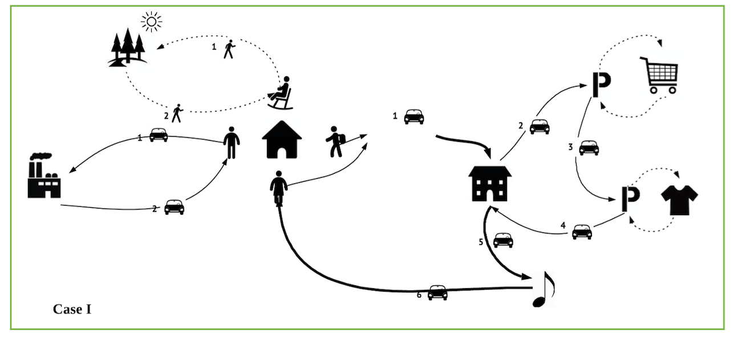
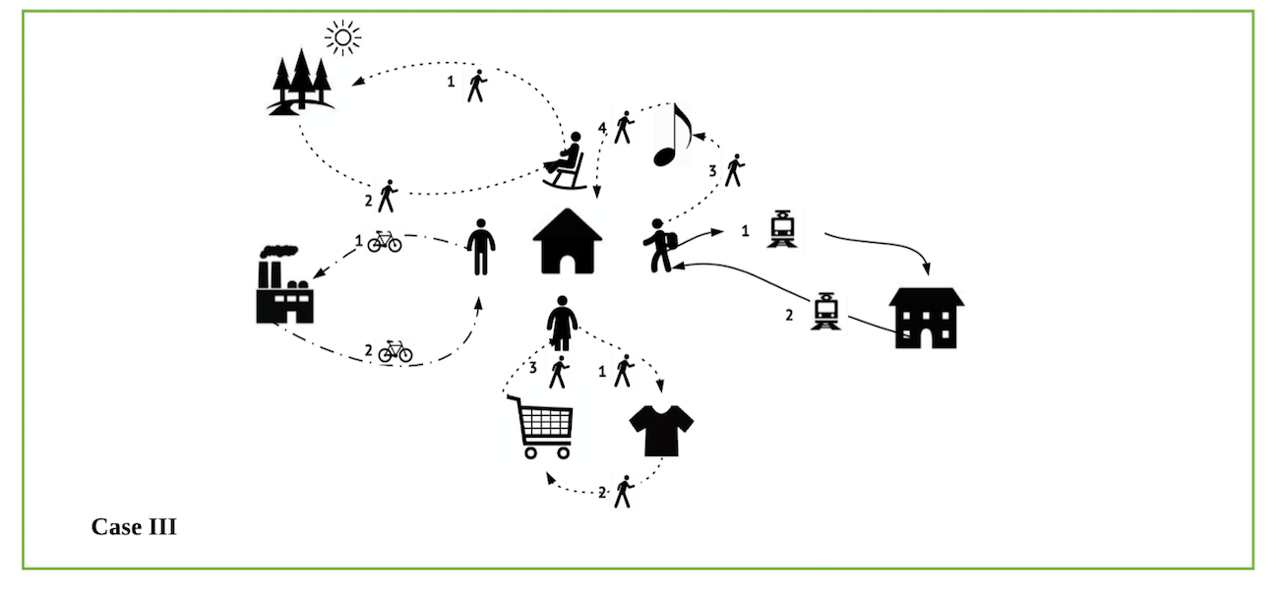
Pedestrian Tours in Different Urban Forms
Guardian 1 (Mom)
Daily
Work
School
Weekly
Groceries
Music lessons
Guardian 2 (Dad)
Child
Weekly
Groceries
Music lessons
Daily
Work
Daily
School
Weekly
Music lessons
Optional
Shopping
Senior
Daily
Recreation
Case I
Case II
Notes:
How pedestrian tours can be different in different urban forms. How pedestrian tours can help with people’s daily activites.
Suppose there is a household, each individuals have many activates need to be accomplished on a typical day.
In Case I, this household rely healily on their autos, because all the destination to accomplish their actiities are far away from each other.
In case II. Areas that contain a mix of commercial, institutional, and recreational uses, allow residents the opportunity to ‘live, work, and play’ in the same area and to move between activities conveniently by walking.
In north America, we’re trying to move away from Case I to Case II. Because it certainly more sustable.

Slide 18
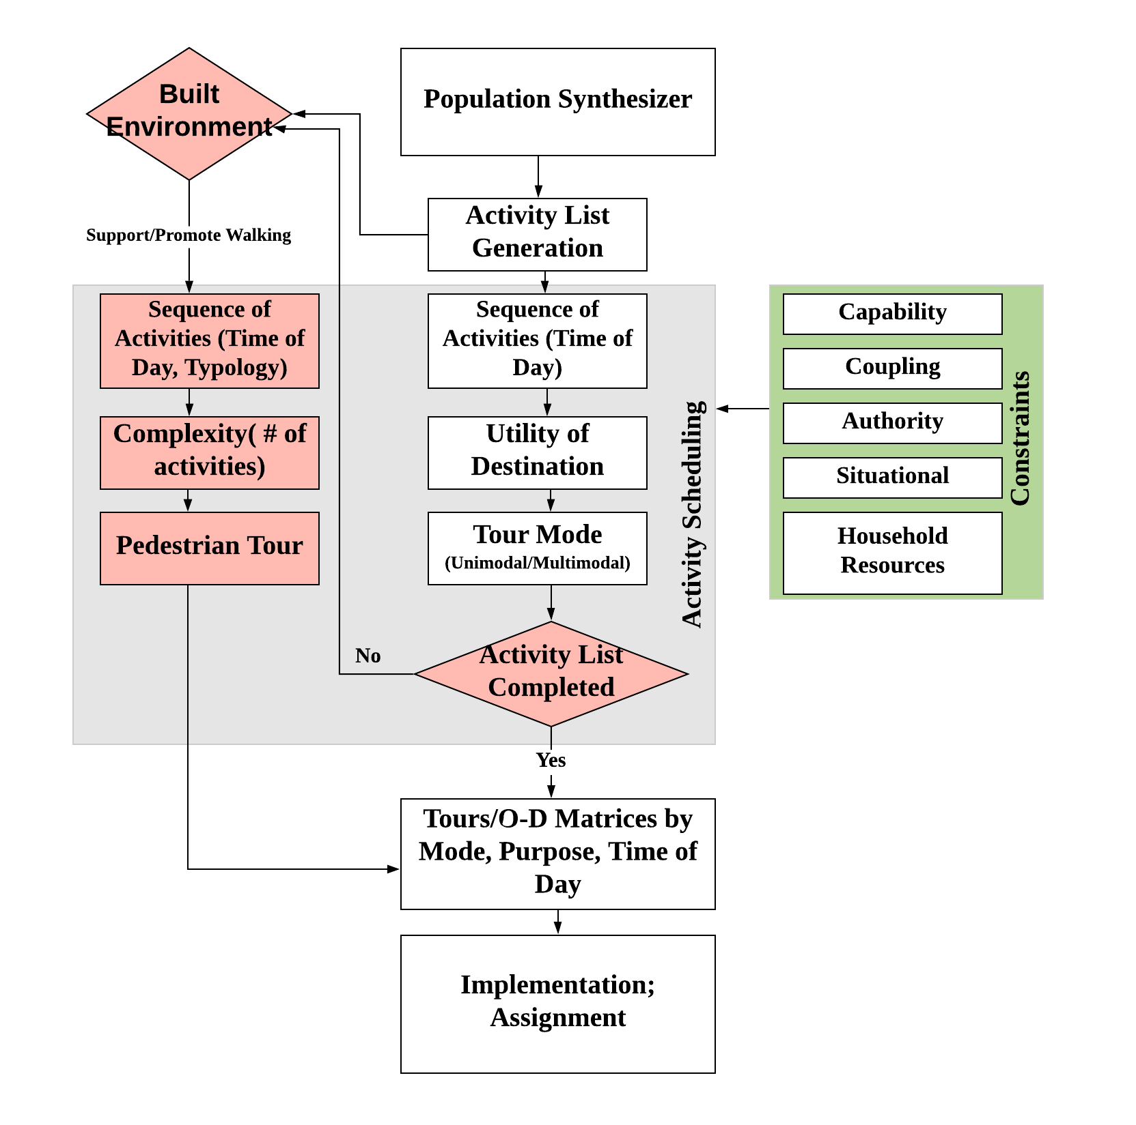
Pedestrian Tours in Activity-based Model
Guardian 1 (Mom)
Daily
Work
School
Weekly
Groceries
Music lessons
Guardian 2 (Dad)
Child
Weekly
Groceries
Music lessons
Daily
Work
Daily
School
Weekly
Music lessons
Optional
Shopping
Senior
Daily
Recreation
Constraints & Scheduling
Walking: time; supervision
Auto: money; vehicles; drivers
Notes:
Now importantly, how pedestrian tours can better represent pedestrians?
When the built environment allows,
How these pedestrian tours can be embedded into activity-based models? One of the option can be

Slide 19
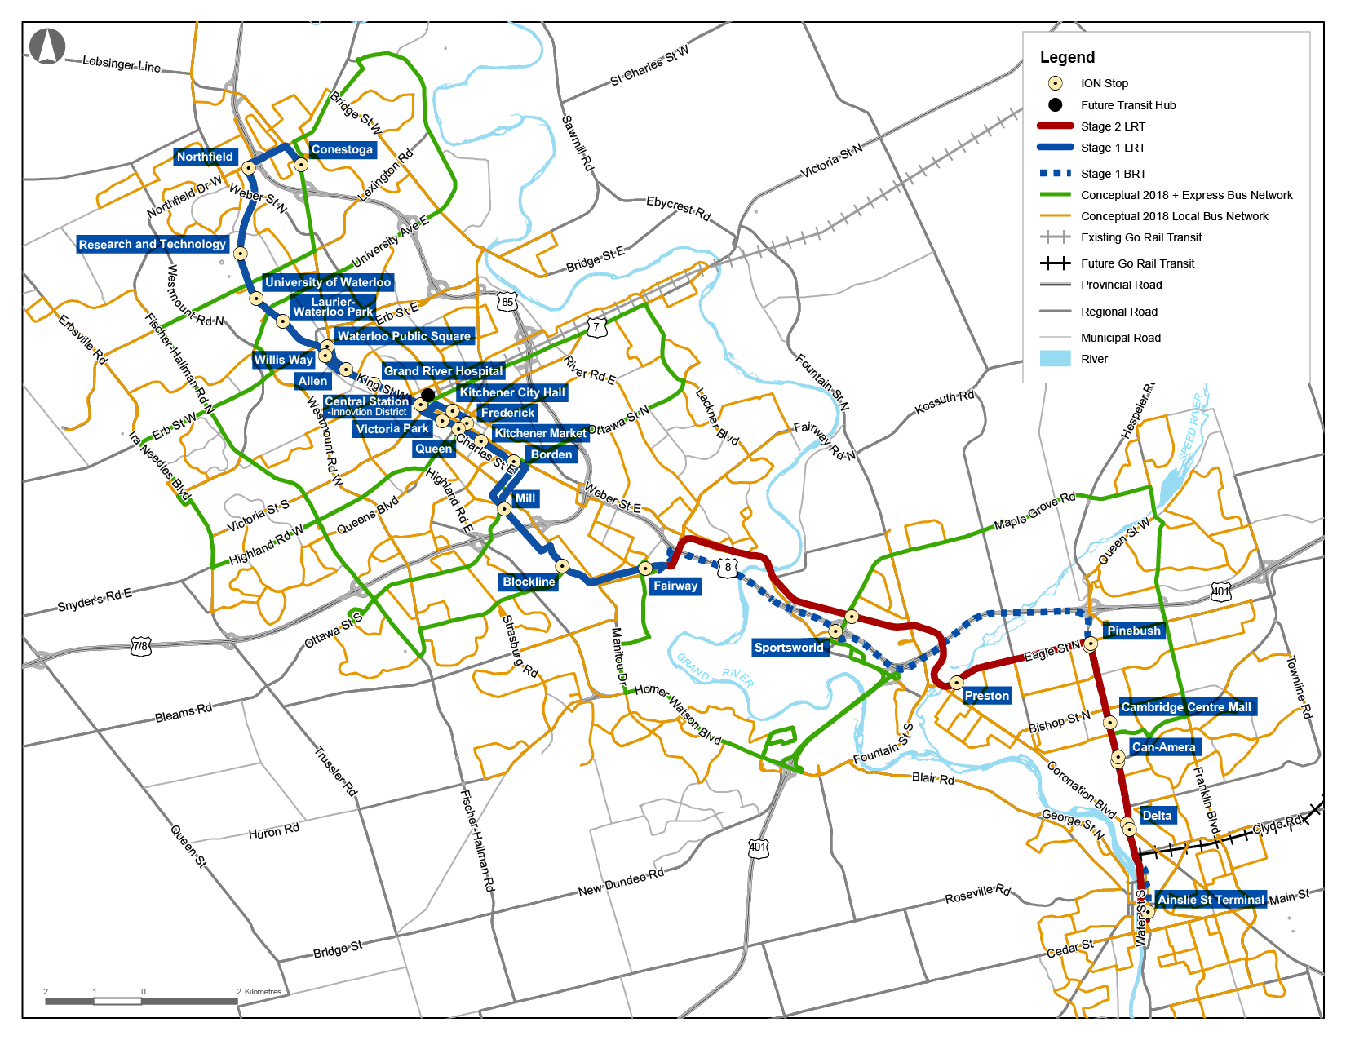
Conclusion and Future Work
Project Goals:
15% of all trips in the Region will be by transit;
12% of all trips will be by cycling or walking
Generate “intensification” – increased diversity and density of land uses in the core
Limit urban sprawl
Project Information:
19 km LRT, 16 km aBRT, 22 stations
$ 818m (32% Fed, 37% Prov, 31% Local)
Construction 2014, Operation June 21, 2019
Notes:
improving access and connections to transit for people can help to not only promote transit but also to encourage more walking.
why integrating transit with walking and cycling is important, including the fact that most people using transit are accessing it by foot or by bicycle,” it reads.
Some of you guys might know that waterloo is going to have our LRT system in operation. We have invested over 800 milllon dollars on this project. If people cannot walk to and from this transit system, the value of this project cannot be realized.

Slide 20
Conclusion and Future Work
Gathering robust, spatially and temporally disaggregate data on pedestrian tours allows for inclusion of pedestrian activities in travel forecasting models;
As a result, investments in or policies towards pedestrians can be evaluated for their impacts on system performance through conventional or activity based models;
Major investments in other transportation modes – LRT for example – or changes in built environment – can also produce changes in pedestrian activities.
Further opportunities and cooperation: passive data collection apps
Notes:
If you are interested in this project, or if you can help us to build a better app, please don’t hesitate to contact us.
We are also looking for cooperations. or halp us to build better app, plesase

Slide 21
Contacts
Ming (Xiaomeng Xu)
xiaomeng.xu@uwaterloo.ca ; 226 978 8186
Professor Jeff Casello, Ph.D., P.E.
jcasello@uwaterloo.ca ; 519 888 4567 ext. 37538
Waterloo Public Transportation Initiative
https://uwaterloo.ca/waterloo-public-transportation-initiative/

Slide 22



Slide 23


Costs of Individual Tours
Low Density
D_{V3}
D_{V2}
Work (D_{F})
Destination 1 (D_{V1})
Home(O)
High Pedestrian
Tours (D_{V4})
Case 1
Case 2
Case 1 Total Cost = ∑ TT + ∑ AT = OD_{F}+D_{F} D_{V1}+AT₁+D_{V1}D_{V3}+…
Case 2 Total Cost = ∑ TT + ∑ AT = OD_{F}+D_{F} D_{V4}+AT₄+D_{V4}O
Maximize HUF = H (u₁, u₂)
Choose pedestrian tour’s utility > auto tour’s utility

