Slide 1
Evaluation of Bus Bridging Scenarios for Railway Service Disruption Management
iCity 3rd Annual Research Day - June 22, 2018
Alaa Itani (alaa.itani@mail.utoronto.ca), Aya Aboudina
Ehab Diab, Siva Srikukenthiran and Amer Shalaby

Slide 2
Introduction
Public transit is an essential service for any city
When unexpected interruptions occur, they reduce the quality of service provided to the public and affect negatively user experience
Thus, transit agencies implement several disruption management strategies to mitigate the impact of unexpected disruptions and incidents on user delays

Slide 3
International Practices for Managing Unplanned Rail Disruptions
Direct commuters to other network lines
Chicago Transit Authority (United States)
Single track operations
Amtrak (United states)
Société de Transport de Montreal (Canada)
Bus Bridging
Toronto Transit Commission, TTC (Canada)
Washington Metropolitan Area Transit Authority (US)
MetroTrains (Australia)
London Underground (United Kingdom)
Notes:
Some agencies direct commuters to other network lines, however this option is limited when buses play the role as feeders to metro network
Other agencies deploy single Track operations; however, this depends on the type of disruption, which might cause the closure of all tracks
The most used strategy in North America and Europe is Bus Bridging

Slide 4
Bus Bridging Strategy
Route A
Route C
Route D
A
B
Route B
Route E
Notes:
According to an international survey conducted for 2 years between 2011 and 2013, most agencies pull buses from existing routes and it is done in ad-hoc procedure. And although transit agencies care to minimize user’s discomfort, they don’t quantify it explicitly.

Slide 5
Bus Bridging Research Efforts
Recent Research Studies
The impacts of generating a temporary shuttle-buses network
Economic analysis of keeping shuttle buses in reserve
Quantifying the impact of bus depots location on travel time of shuttle buses
Few efforts focus on quantifying the impact of pulling shuttle buses from scheduled services on the overall system performance, including bus riders.
Notes:
In addition, no efforts are found in comparing different bus bridging response plans

Slide 6
Objectives
Develop a data-driven analytical tool for estimating:
User delays
Assess different bus bridging response plans
Provide transit agencies with a decision support tool for the selection of appropriate response plans
Shuttle bus performance
Notes:
User delays is estimated for both, subway passengers affected by the disruption and bus riders where the shuttle buses are dispatched from. Shuttle bus performance measures such as the time spent serving as shuttle versus the time spent traveling on read to the incident location, known as deadhead time. The tool is then used to asses different bus bridging response plans and by that we show how transit agencies can use this tool to deploy the optimal bus bridging scenario.

Slide 7
User Delay Modelling Tool Methodology
1) Shuttle Bus Trip Tracking
Metro incident reported to control center
Shuttle buses returned to regular service
Initial response time
Deadhead time (II)
Buses Requested
Incident cleared
Bus pull out time
Shuttle service time
Buses retracted from route terminals
Buses on Shuttle Service
Deadhead time (I)
Notes:
Explain briefly how the tool tracks shuttle buses from the moment the incident is reported until the bus returns to its original route

Slide 8
User Delay Modelling Tool Methodology
2) Metro Passengers Queue Evolution
# of Passengers
Total Subway Passenger’s Delay = Area between Curves
Arrival Curve at station A or B
Train load
Departure Curve
Time
Start of Disruption
End of Disruption
Notes:
Deterministic queuing: This figure shows the queues evolution at a disrupted end station where both, through and local traffic are included in the arrival curve.
Arrival curve describes the arrival of passengers to the disrupted station shown in red. Departure curve of passengers is described by the arrival of shuttle buses at the stations along with the available capacity inside the bus. The delays at each station are estimated as the area between both curves.

Slide 9
User Delay Modelling Tool Inputs
1) Bus Bridging Scenario Specification Information
Incident Related Information | Incident location (start and end stations of the disrupted railway segment).
 | Incident start time and expected duration.
Shuttle Buses Related Information | Number of shuttle buses to be dispatched ($N$).
 | Selected bus routes from which shuttle buses will be dispatched.
 | The number of buses to be dispatched from each route ($N_{i}$).
 | The end station (A or B) to which each shuttle bus will be initially dispatched.
Notes:
The tool requires two major types of input data, one is related to the bus bridging strategy specifications such as incident location, number of shuttle buses, the routes from where the shuttle buses are dispatched from, etc.

Slide 10
User Delay Modelling Tool Inputs
2) Transit Demand/Service Data and Travel Time Info
Transit Demand/Service Data | Railway Segment Related Data | Train loads and arrival frequency at both ends of the disrupted segment.
 |  | The arrival rate of local transit users at each station/direction along the disrupted segment.
 |  | The average number of alighting passengers at each station/direction along the disrupted segment.
 | Bus Routes Related Data | Bus service frequency.
 |  | Bus average ridership (i.e., total number of boarding passengers) per cycle.
 |  | Bus average cycle time.
Travel Time Data (Traffic Network) |  | Travel time of each shuttle bus between the closest route terminal to the disrupted railway segment and one end of the segment (i.e., bus deadhead times).
 |  | Bus travel times between adjacent stations along the disrupted railway segment.
Notes:
The second type of input is related to the transit and traffic network from which travel times, ridership, and scheduled service data are determined.

Slide 11
User Delay Modelling Tool Outputs
Estimates for each Disrupted Station
Estimates for each Shuttle Bus
Metro passenger delays
Shuttle bus fleet arrival times and associated occupancy levels throughout the disruption period
Queue length at the end of disruption
The maximum passenger queuing delay
The maximum queue length
The delay associated with queue dissipation following end of event
Estimated Aggregate Values
Rider delays
Out-of-original-service time
Shuttle in-service time
Bus utilization check
Total metro passenger delays
Total bus rider delays
Total user delays (both)
Total bus waste time (of non-utilized buses)
The percentage of utilized shuttle buses
Notes:
The tool is also capable of getting detailed statistical information about all measures above such as the average waiting time, maximum delays, bus rider’s delay for each shuttle bus route, and so on.

Slide 12
TTC Case study: Evaluating Bus Bridging Response Plans
DAILY BUSES ALLOCATION Y.U.S / B.D
 |  |  | 30 MIN + | 30 MIN + | 30 MIN + | 1 - 30 MIN | 1 - 30 MIN | 1 - 30 MIN
 | TIME FRAME | Total buses | 1 - 4 STATIONS | 5 - 9 STATIONS | 10 + STATIONS | 1 - 4 STATIONS | 5 - 9 STATIONS | 10 + STATIONS
A.M | 6 - 9 AM | 1325 | 44 | 88 | 133 | 22 | 44 | 66
MID | 9 AM – 3 PM | 881 | 29 | 59 | 88 | 15 | 29 | 44
PM | 3 – 7 PM | 1426 | 47 | 95 | 143 | 24 | 47 | 71
E.E. | 7- 10 PM | 819 | 27 | 55 | 82 | 14 | 27 | 41
LE. | 10PM - 1AM | 506 | 17 | 34 | 51 | 8 | 17 | 25
Notes:
In order to Validate and test the effectiveness of the tool, TTC was taken as a case study
TTC subway system extends to a total length of 68 km serving 69 stations.
The TTC dispatching policy determines the number of required shuttle buses based on:
Expected delay (i.e., 1 to 30 min, 30+ min)
Affected stations (number of stations and line)
Time period
Current issues in these practices: no clear criteria for selecting buses for shuttle service, the policy could deploy inefficient bus bridging strategies leading to: Excessive deadhead time (as long as 1 hour) Non-utilized shuttle buses turning back before serving as shuttle (Excessive wasted time)
The number of dispatched buses < number of requested

Slide 13
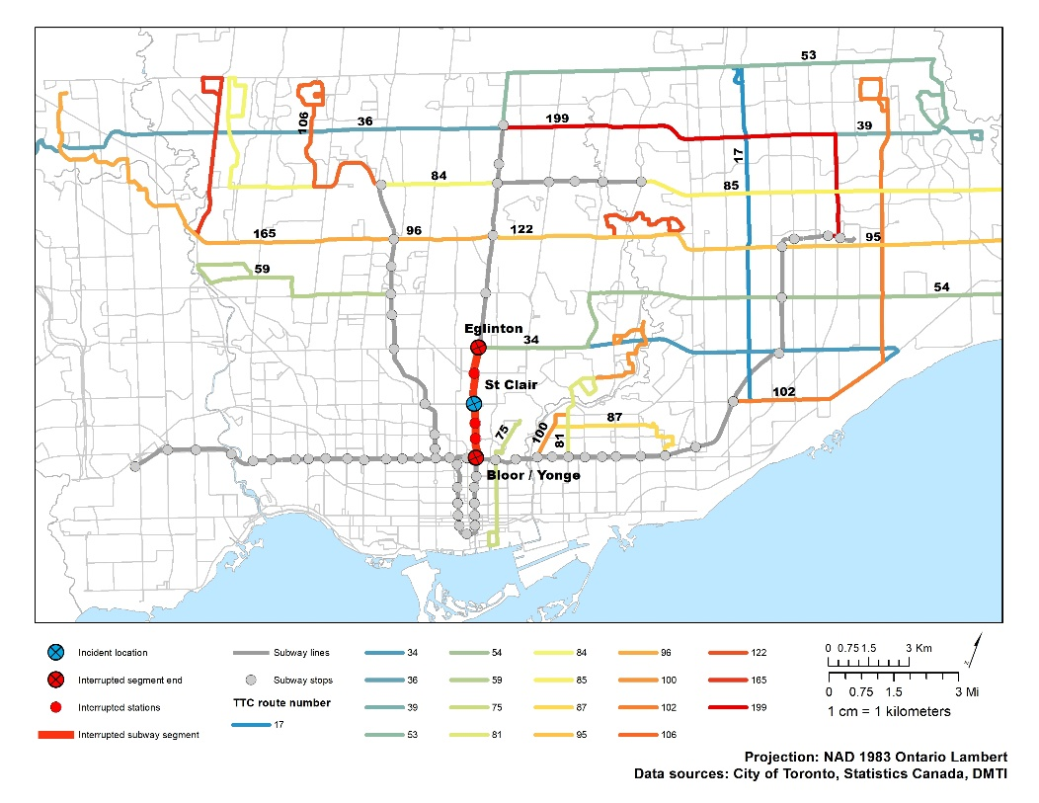
Selecting an Actual Disruption
Disruption occurred at St. Clair station between 5:54 and 6:25 am on a weekday.
The disrupted segment is part of Yonge-University Line (Line1), and it extends between Bloor-Yonge (BY) and Eglinton station
Inclusively, 6 stations are closed
The Incident duration was 31 min
23 buses were dispatched
Notes:
We ran the tool/simulation using disruption data obtained from TTC in which 144 incidents in 2015 required bus-bridging services. The figure shows the disrupted segment as part of the network operated by TTC in Toronto. The incident occurred during the morning peak hour and closing 6 subway stations. At that time, the agency selected 23 shuttle buses from different routes in the system to serve as shuttle (bus routes are colored).

Slide 14
Running the Tool Using the Selected Incident
1,729
94
18
77
57
5.7 bus-hr wasted time
22.5
North Bound Platforms
South Bound Platforms
7
20
5
734
Delays at the Disrupted Subway Stations (Passenger-hr)
Notes:
The pie chart shows that only 15 buses out of the 23 dispatched shuttle buses reached the disrupted segment and served as shuttle. This resulted in a total of 5.7 hr wasted time. The second figure show the predicted delays at each disrupted subway station in both directions, north and south.

Slide 15
Observed Vs. Estimated Measurements
Notes:
The user’s delay is not reported by TTC, hence we validated the tool through other performance measures related to shuttle buses
Relative validation
Travel time data was obtained from google maps in May, 2017
Ridership data of both, subway passengers and bus riders, is that of 2011
The buses are pulled from the closest route terminal to the end station it will start serving from. (Almost half of the buses start the shuttle service from Bloor-Yonge station)

Slide 16
Tested Bus Bridging Strategies
Bus Bridging Scenarios
Scenario 0: “Baseline Scenario”
Scenario 1: “Shorter Incident”
Scenario 2: “BY ALL”
Scenario 3: “Eglinton ALL”
Scenario 4: “Fewer Buses”
Scenario 5: “Different Routes”
Modified Specifications
No modification
Incident duration reduced from 31mins to 25mins
All shuttle buses are dispatched to Bloor-Yonge station first
All shuttle buses are dispatched to Eglinton station first
Number of shuttle buses reduced from 23 to 15
Shuttle buses are dispatched from nearby routes.

Slide 17
Assessing Alternative Strategies: Smaller-Size Shuttle Fleet and Nearby Routes
Non-utilized shuttle buses
Reduction in:
Notes:
If TTC knew that 8 buses won’t serve, they would have saved 50% of bus riders delay without affecting subway presenters
Actually, they could have tested other routes that are closer: here comes another response plan
When selecting the 8 shuttle buses from closer routes, all 23 shuttle buses served as now they spend less time on the road. Thus cutting off bus riders delays, subwy passengers delays, and no more wasted time is observed.

Slide 18
What’s Next?
Sensitivity
Compare different bus bridging response plans
Robust Validation
Use more recent data, once available
Optimization Framework
Develop an optimization model which utilizes the user delay modelling tool to determine the optimal bus bridging response plan under a given set of conditions
Determine the major factors that affect user delay
Validate the tool using more incidents

